Slide 2
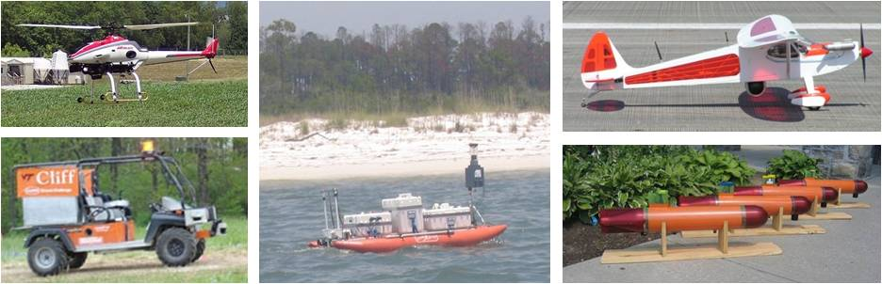
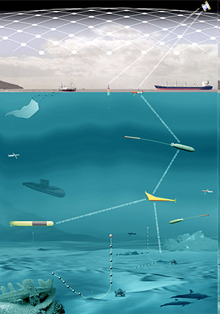
Visual Interfaces for Autonomous Vehicles
Nicholas Polys & Craig Woolsey
AUV W snapshot
Picture
Challenges:
Multiple operators sharing situational awareness (front and rear)
Easy navigation in geospatial graphics
Visualizing Uncertainty
Notes:
Vision Slide
http://www.defensetech.org/archives/2007_03.html

Slide 3
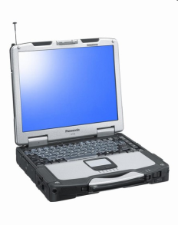
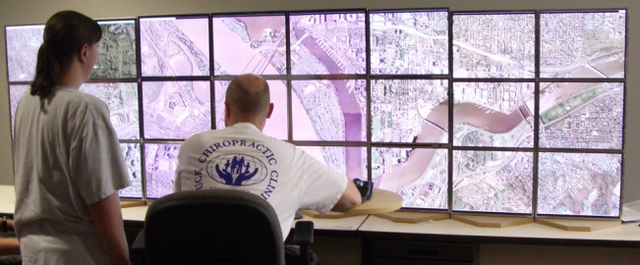

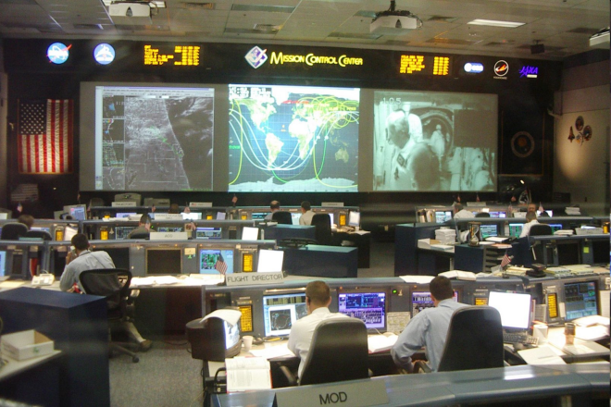
Simulation and Supervision of Autonomous Vehicle Networks
Objective
To provide fundamental advances in the capability and usability of AxV data tools for the design and the ‘3 R’s’: Rehearse, Run, and Replay
Approach
To develop new data and visualization capabilities for the AxV Workbench software in collaboration with the Naval Postgraduate School (NPS)
Apply new methods in information layout, geospatial navigation and empowering collaborative work
Evaluate and validate interface features across platforms through human factors experiments
Display Interfaces:
PDAs,
Laptops,
Tiled and Projection Displays
Benefits
The suite of tools resulting from this usability engineering process will yield dramatic improvements in efficiency and flexibility for mission planning, mission management, and post-mission analysis. Through the human factors studies, these benefits will be empirically demonstrated.
Major Accomplishments
Initial Requirements and Tools Survey
AuvFest 2008 participation [ONR, NOAA]
Software Development & Integration:
        - Visualization tools for Engineering teams (VT)
- Visualization interface for Operators (NPS)

Slide 4
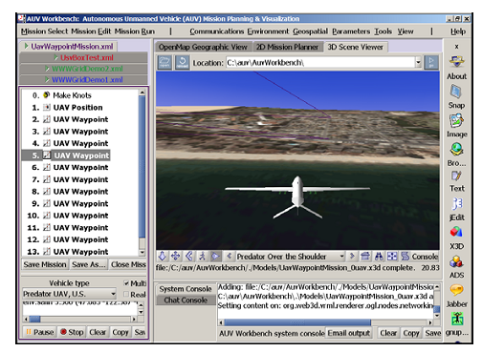
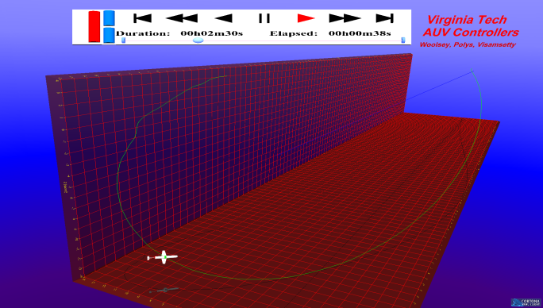
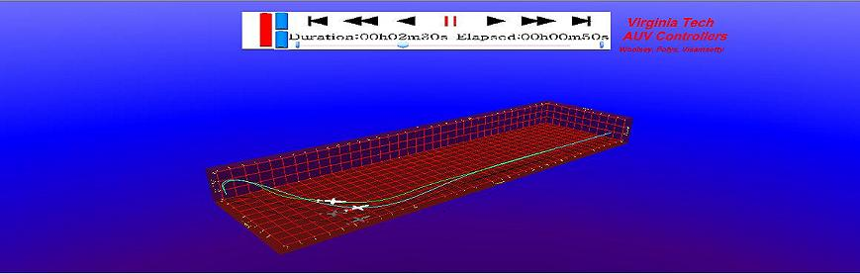
Autonomous Vehicle Visualization
In collaboration with Naval Postgraduate School (NPS) and VACAS

Slide 5
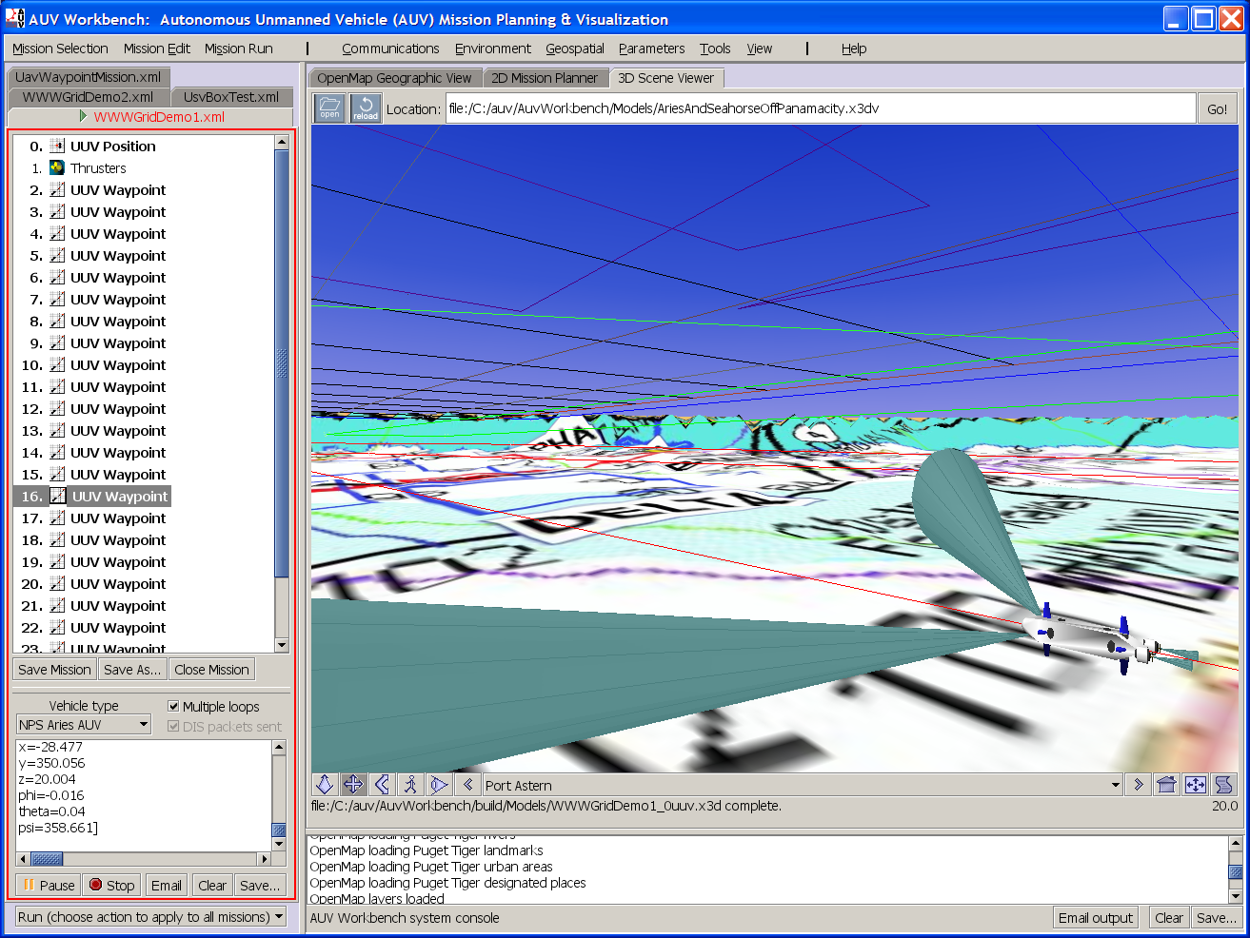

Visualization, mission planning
mission
commands
robot
execution
6DOF response
hydrodynamics
NPS AUV Workbench

Slide 6
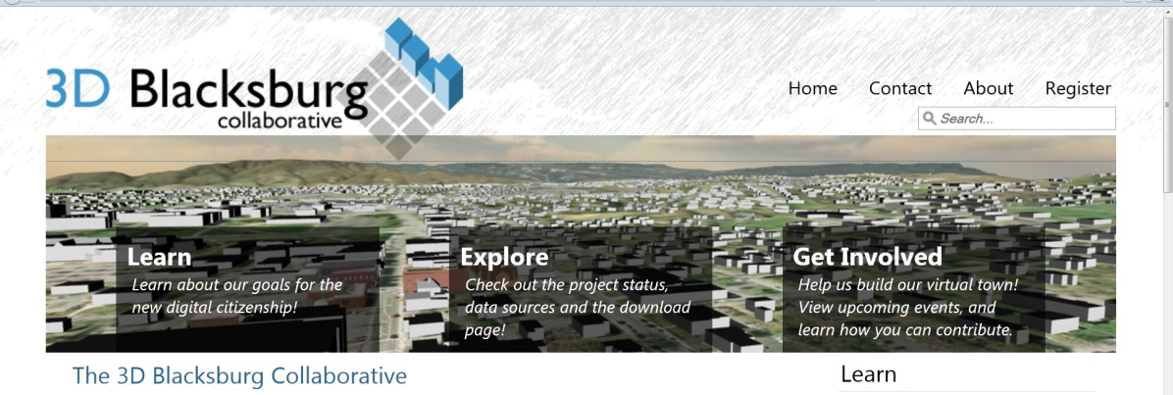
3D Blacksburg
Web-published GIS and 3D collections, services
Standards-based, cross-platform web visualization
Internal and public (CC-A) use versions
Goals:
  A vibrant, engaged and informed community
  A durable and interoperable platform with which to conduct studies on planning, environment, energy, safety, transportation and economy

Slide 7
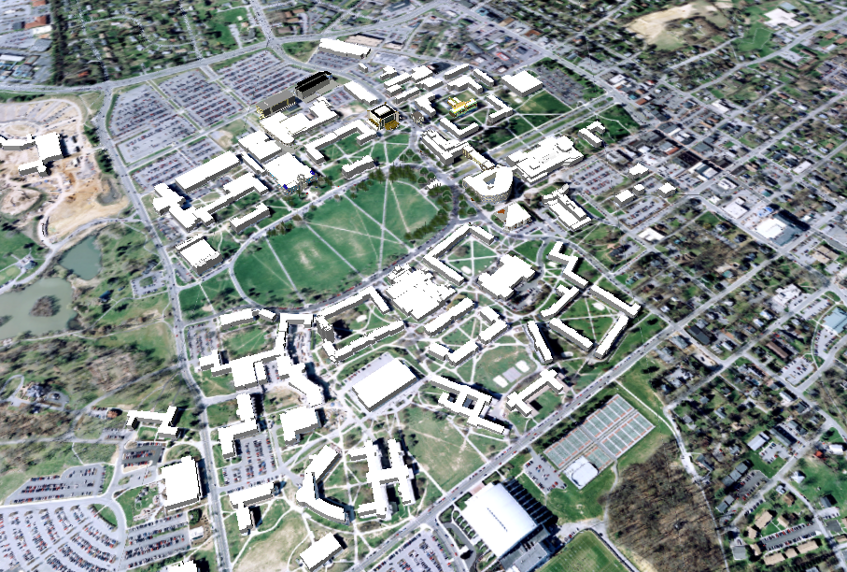
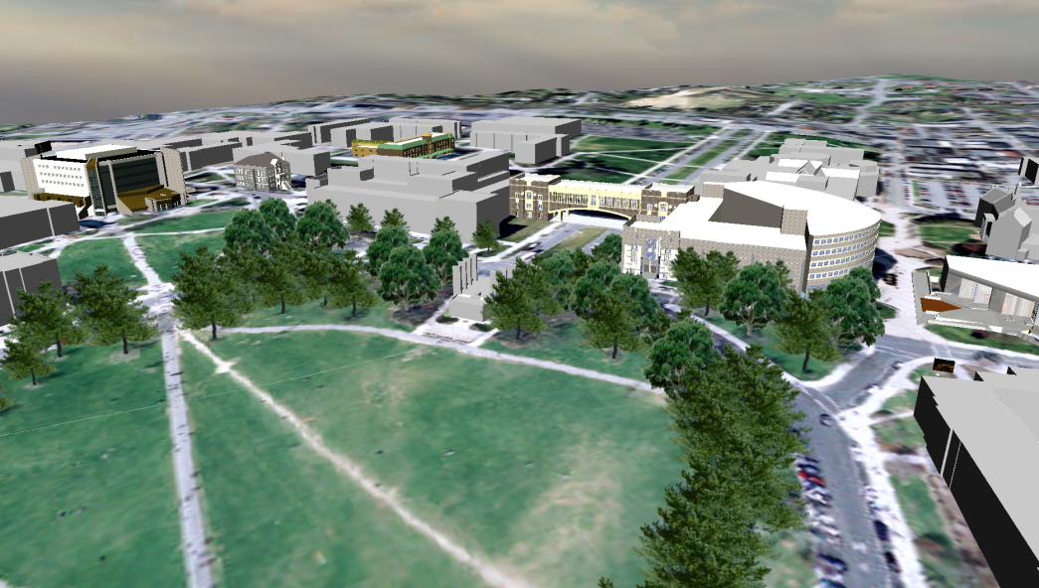
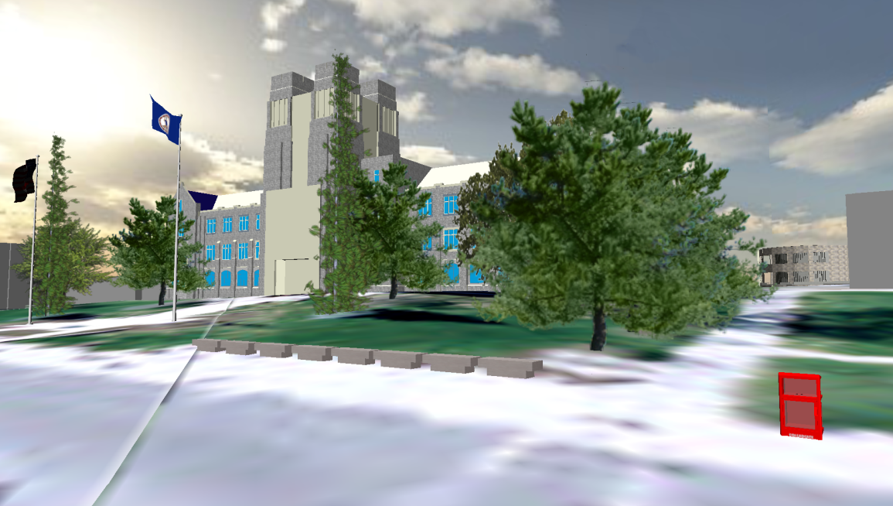
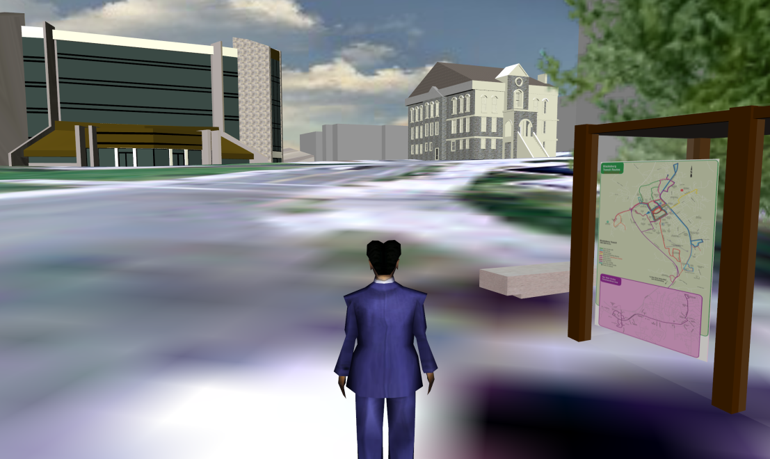
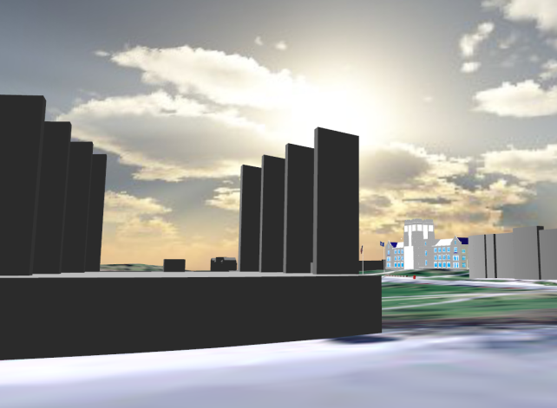
X3D VT

Slide 8
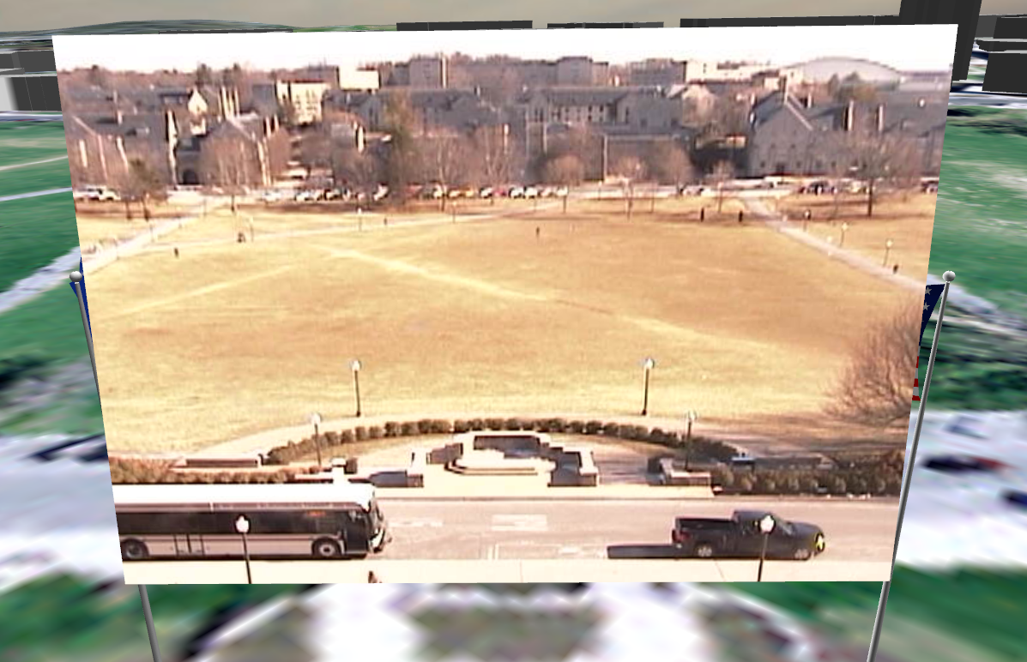
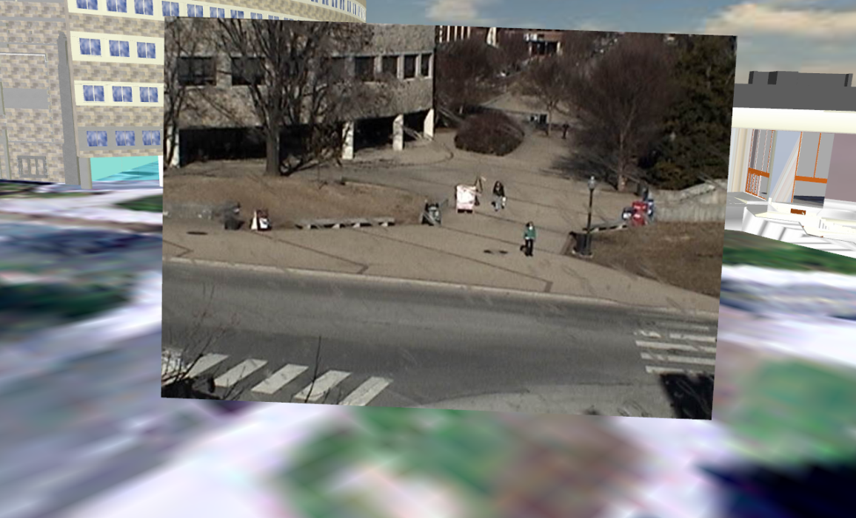
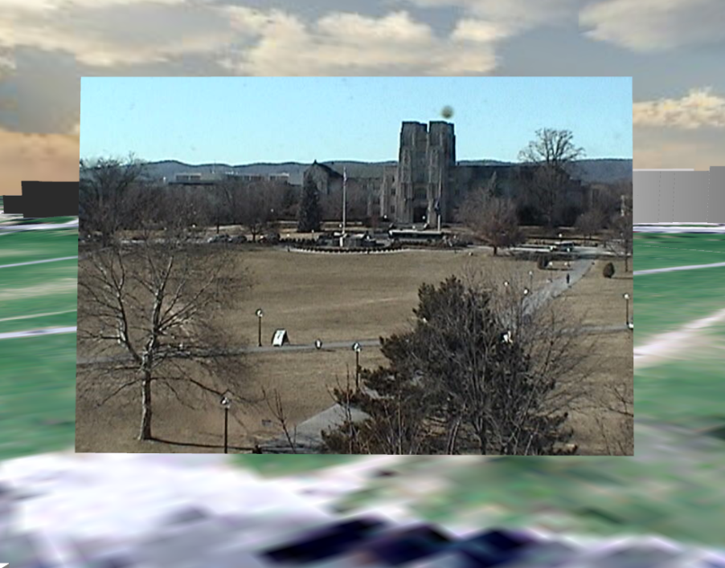
Live webcam feeds in
3D VT:
X3D & KML

Slide 9
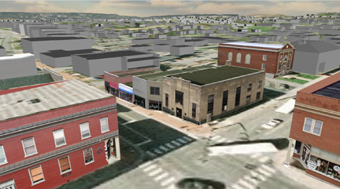
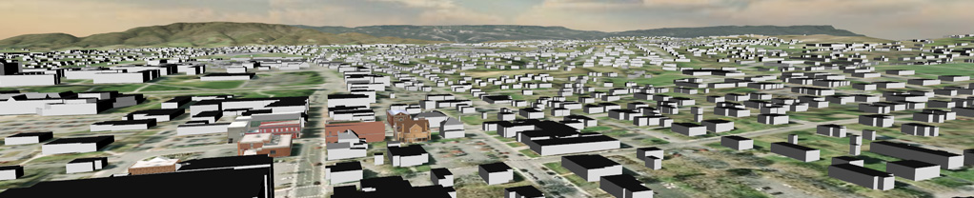
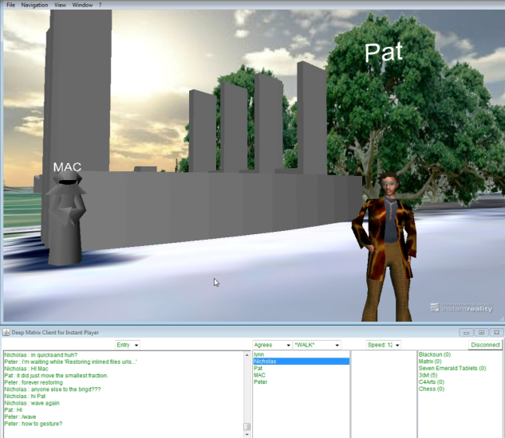
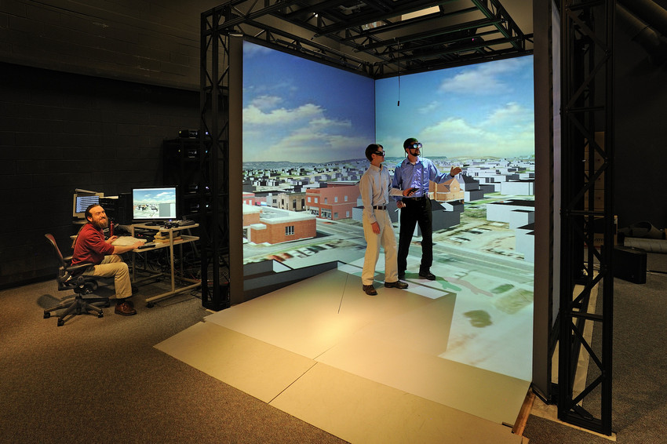
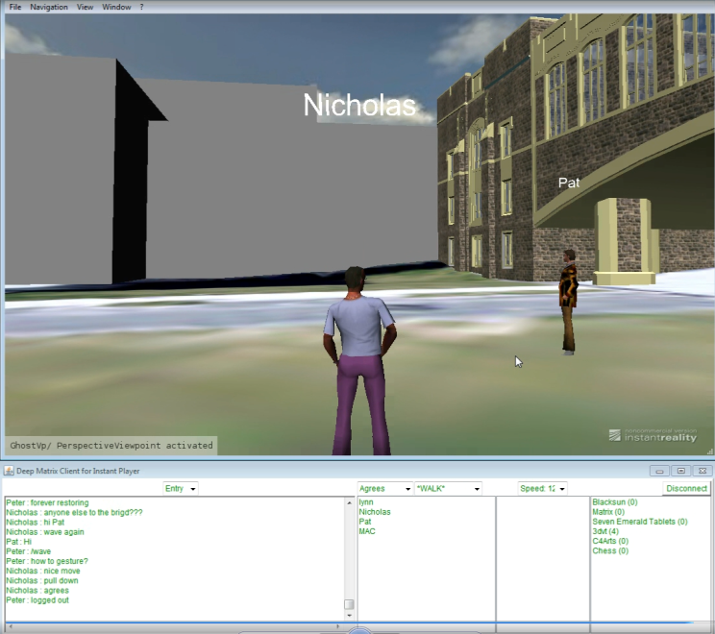
X3D Blacksburg v.2011
Town & Building LODs
X3D shared multi-user
VT Campus
X3D Immersive

Slide 10
Contacts
Nicholas F. Polys, Ph.D. npolys@vt.edu
Director, Visual Computing http://www.arc.vt.edu/
Peter Sforza sforza@vt.edu
Director, Center for Geospatial Information Technology http://www.cgit.vt.edu
www.3dblacksburg.org

Slide 11
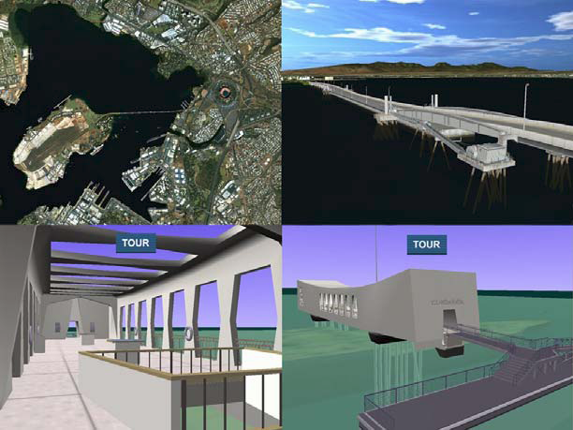
Harbor Defense Simulation
Naval Postgraduate School (Don Brutzman)
X3D + Distributed Interactive Simulation (DIS) protocol scaled
to over 500
simultaneous
tactical users

Slide 12
