Slide 1
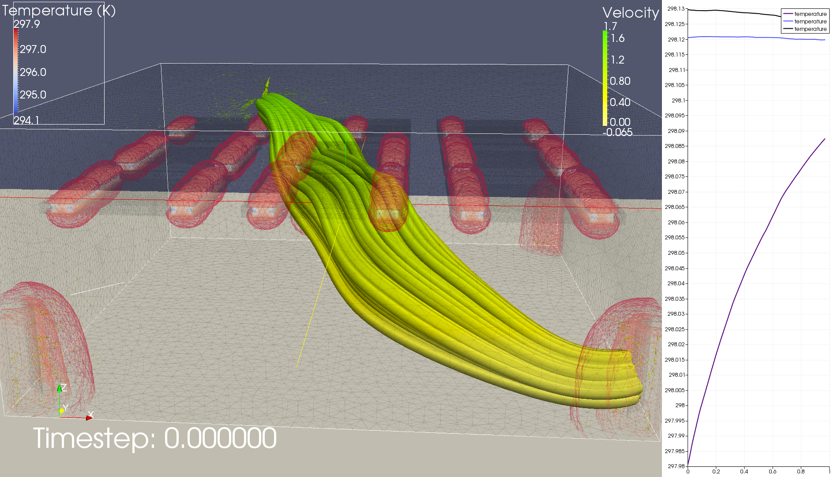
Temperature profile (K) at 3 desks (2 corners and middle; 100 samples each)
3D rendering with pressure streamlines and glyphs and temperature contours and volumes
Notes:
T = 0

Slide 2
Notes:
T = 0

Slide 3
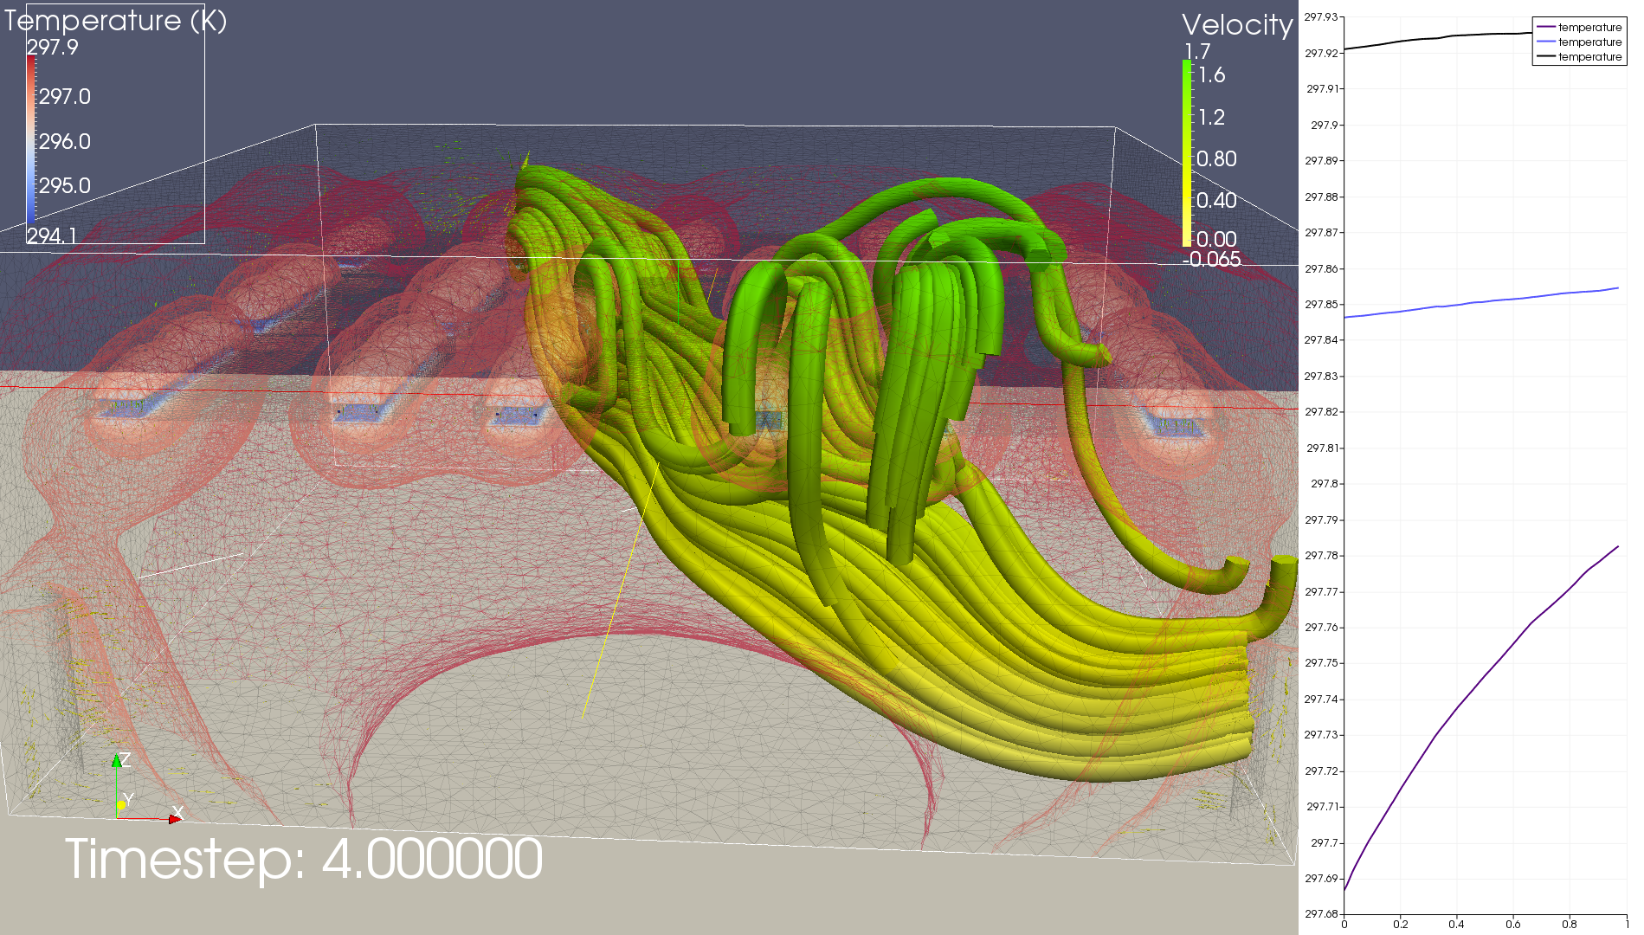
Notes:
T = 4

Slide 4
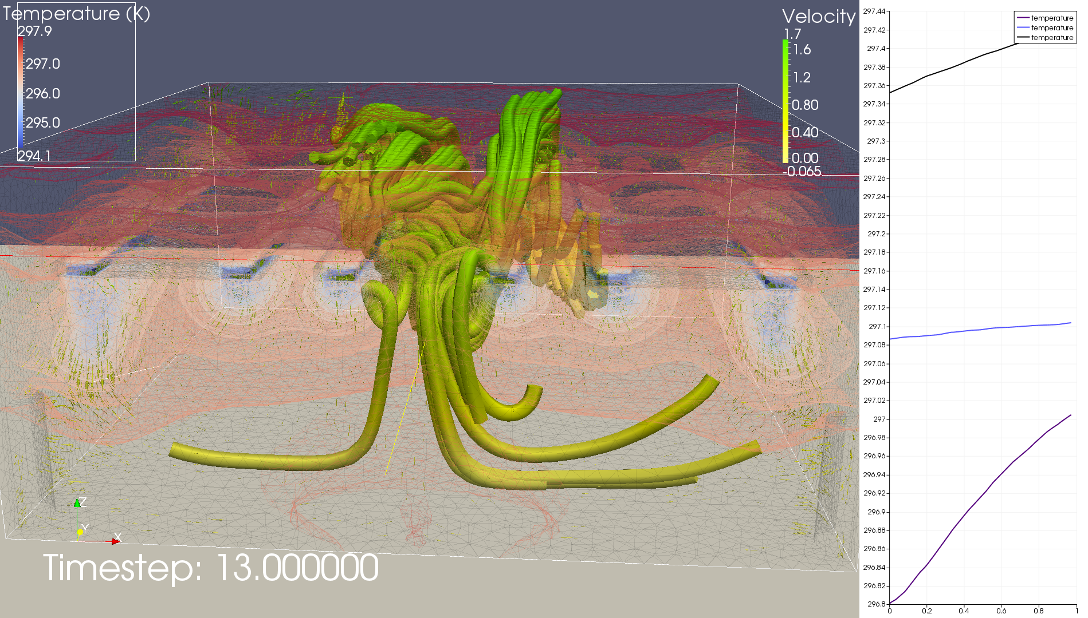

Slide 5
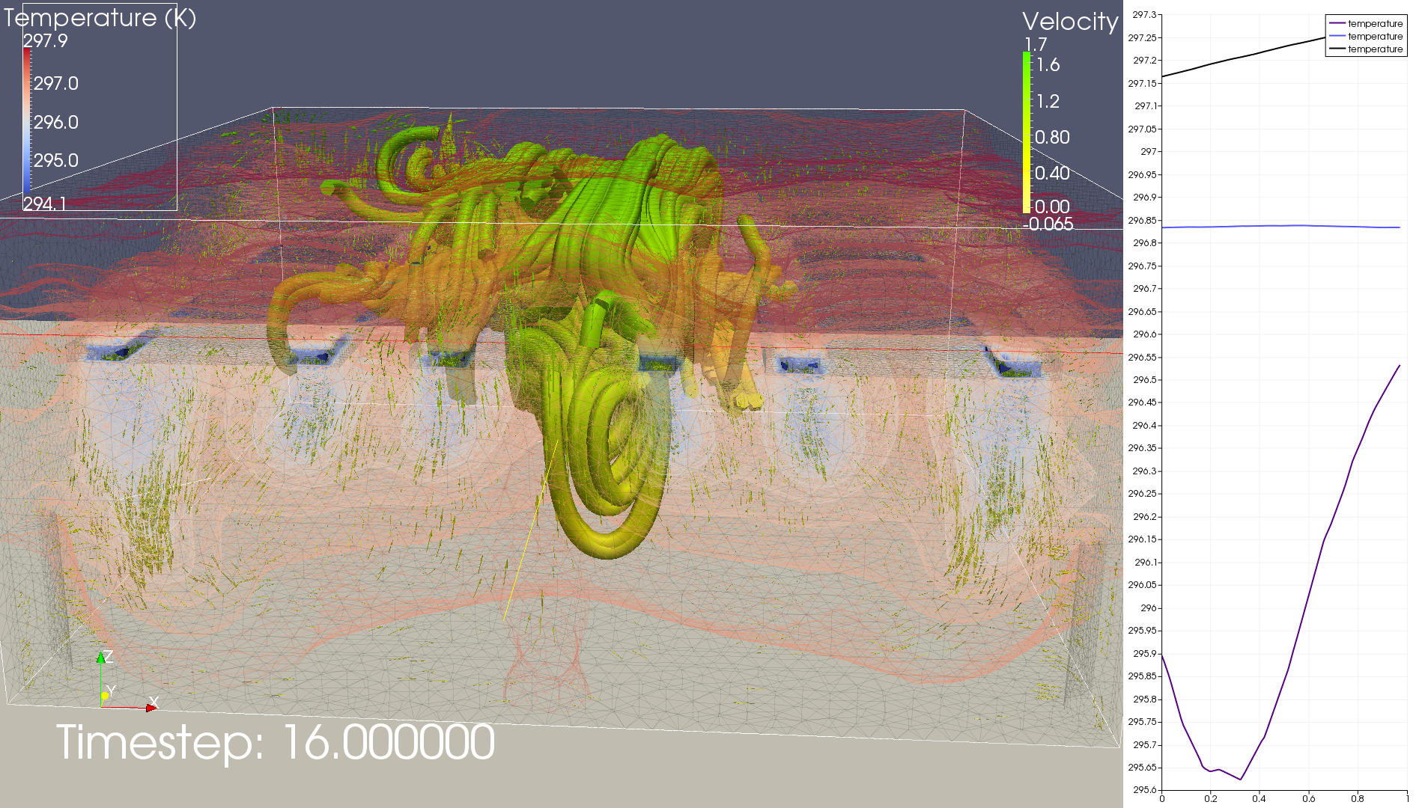

Slide 6
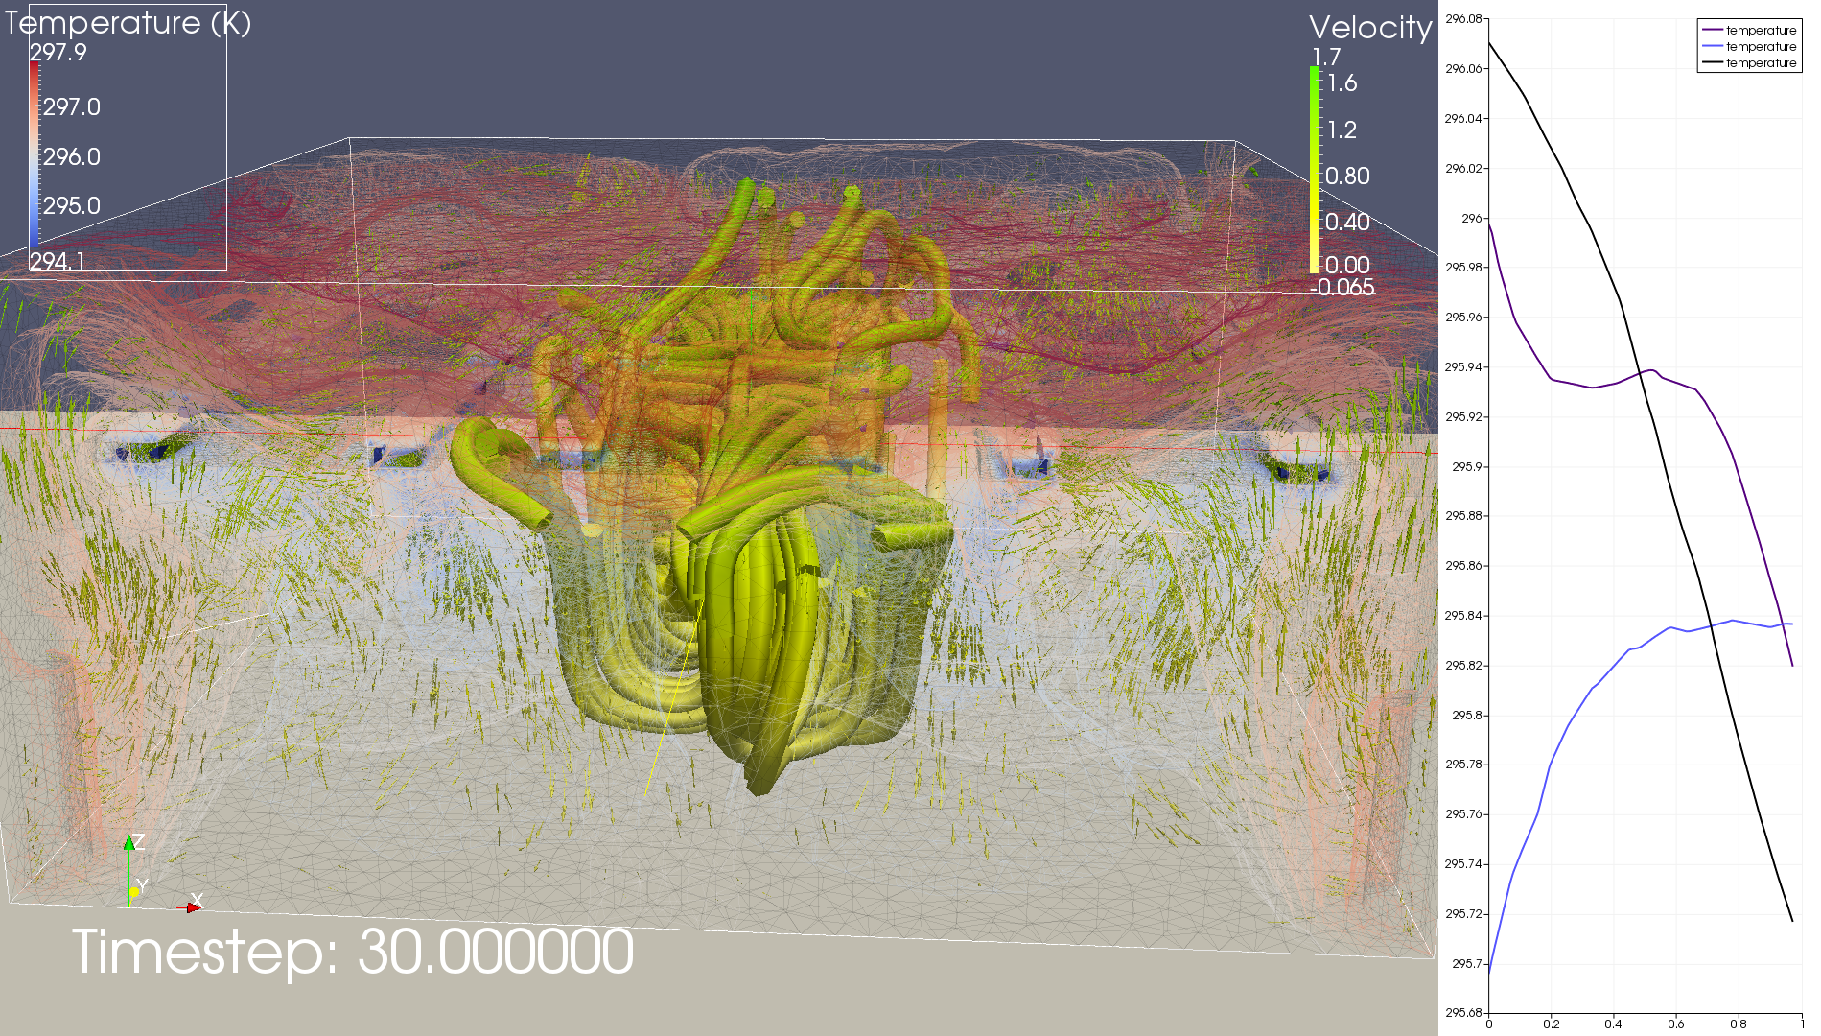

Slide 7
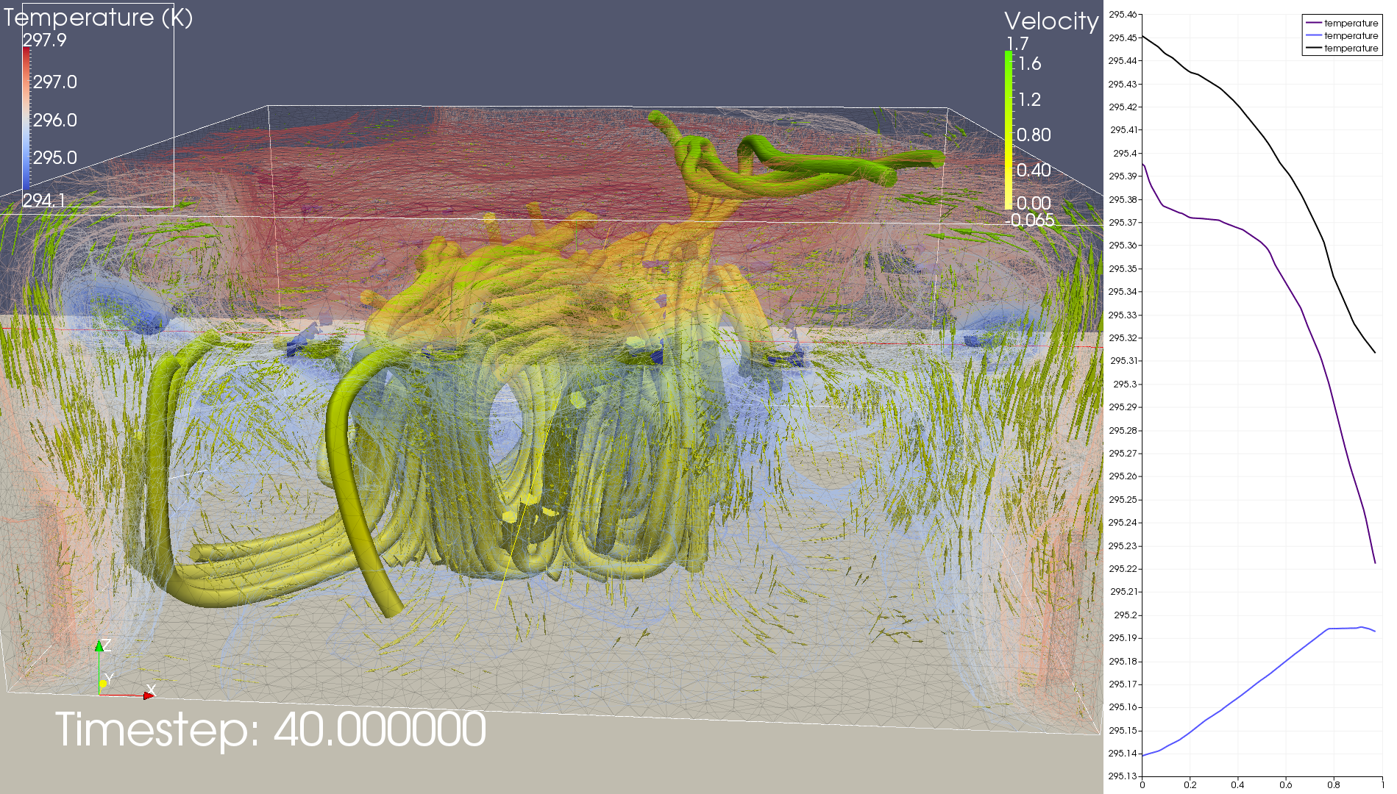

Slide 8
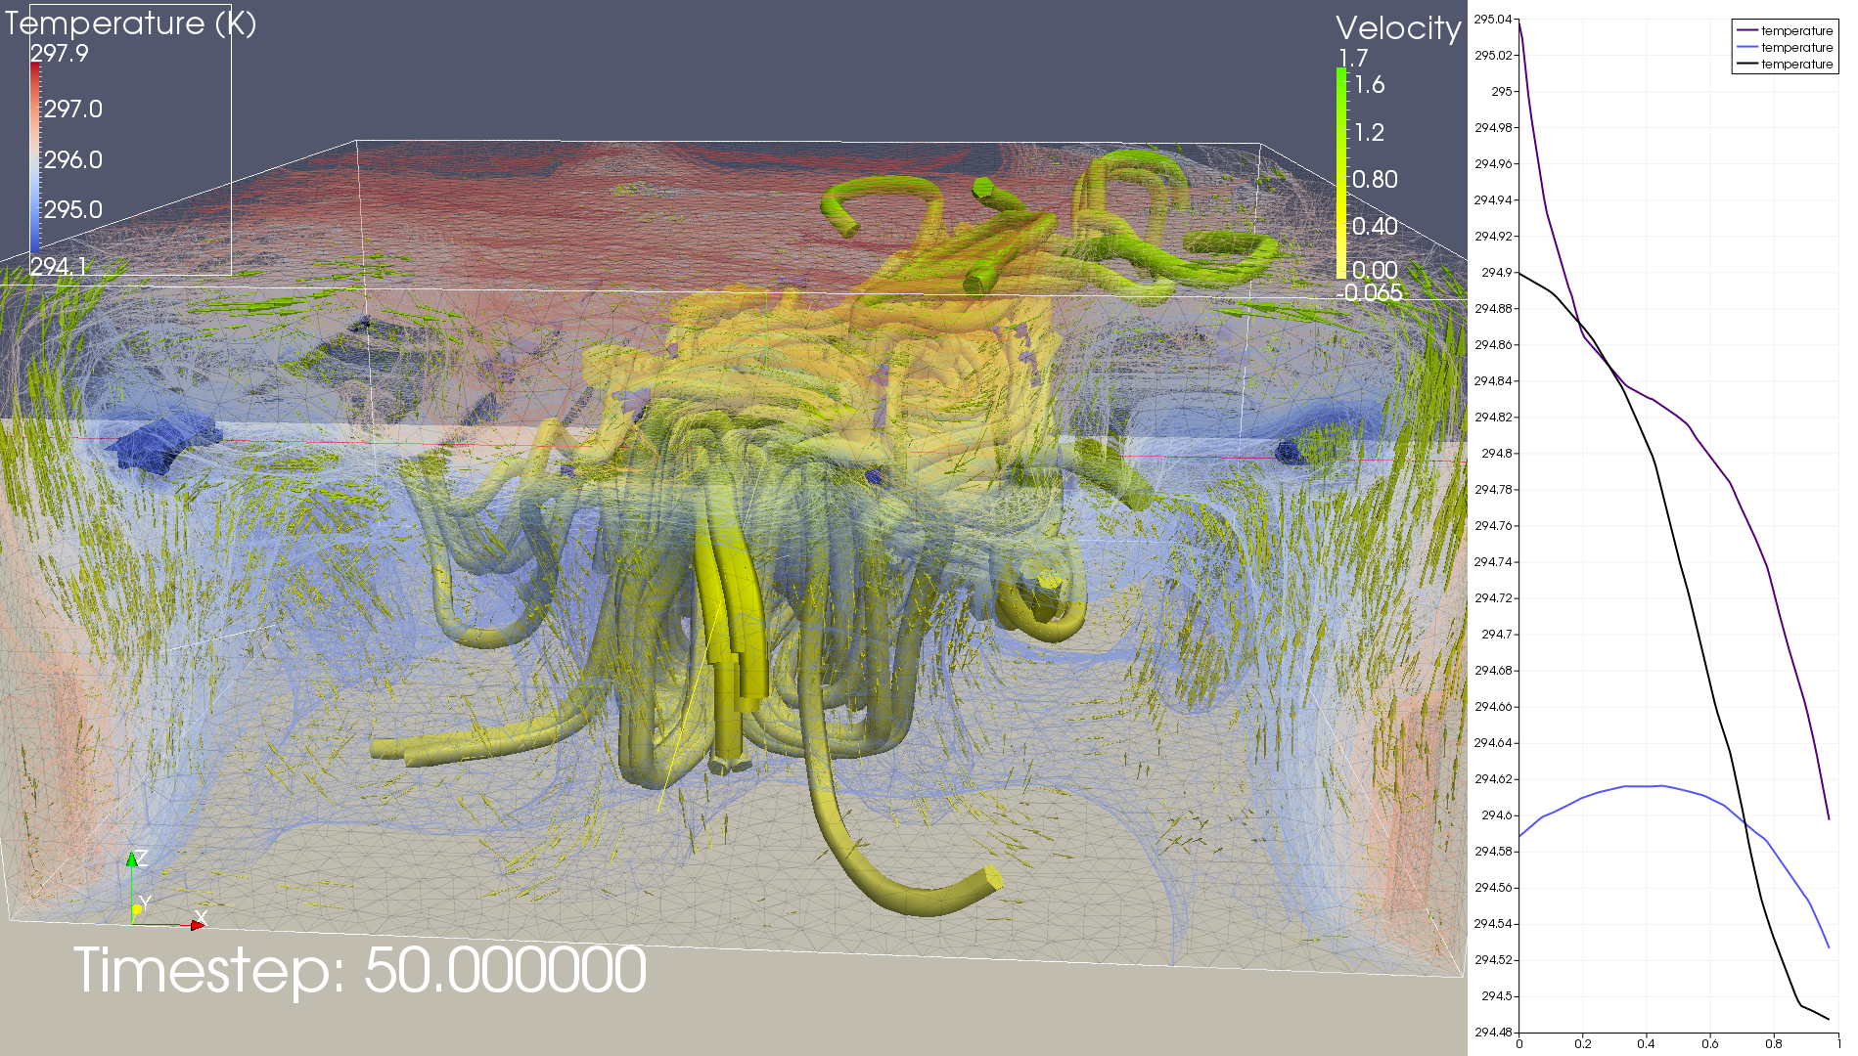

Slide 9
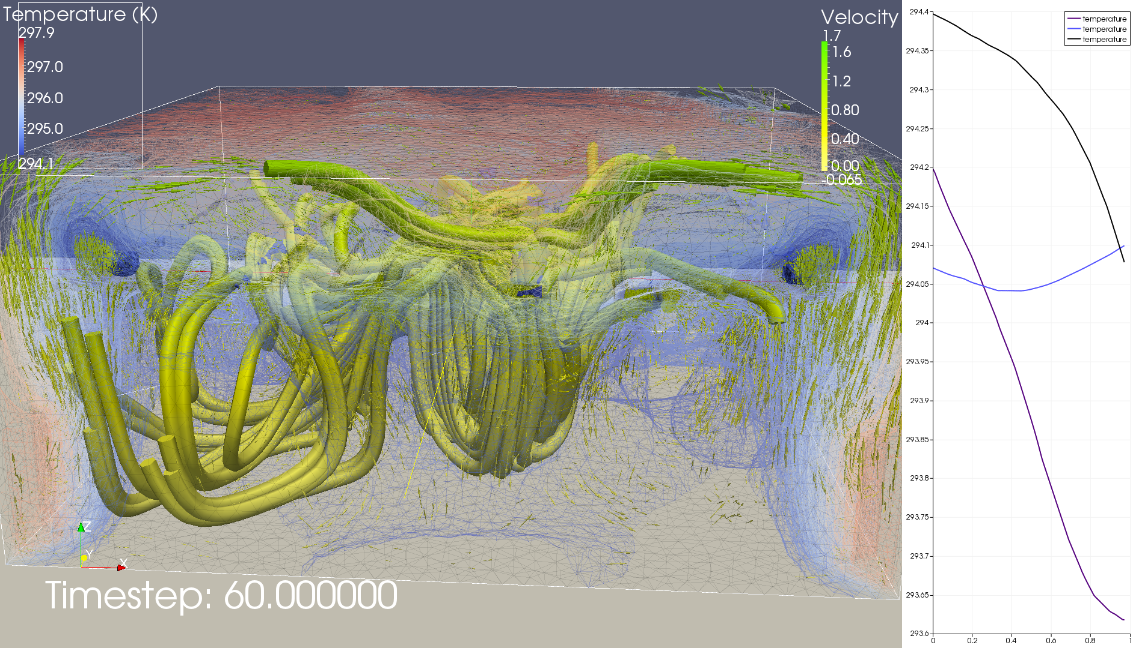

Slide 10
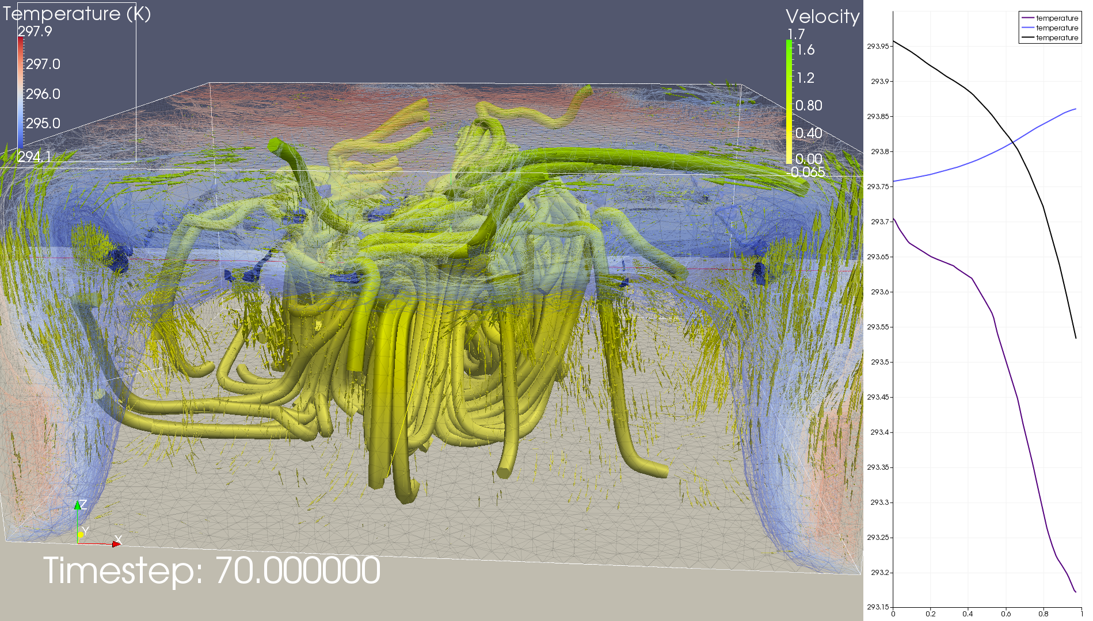

Slide 11
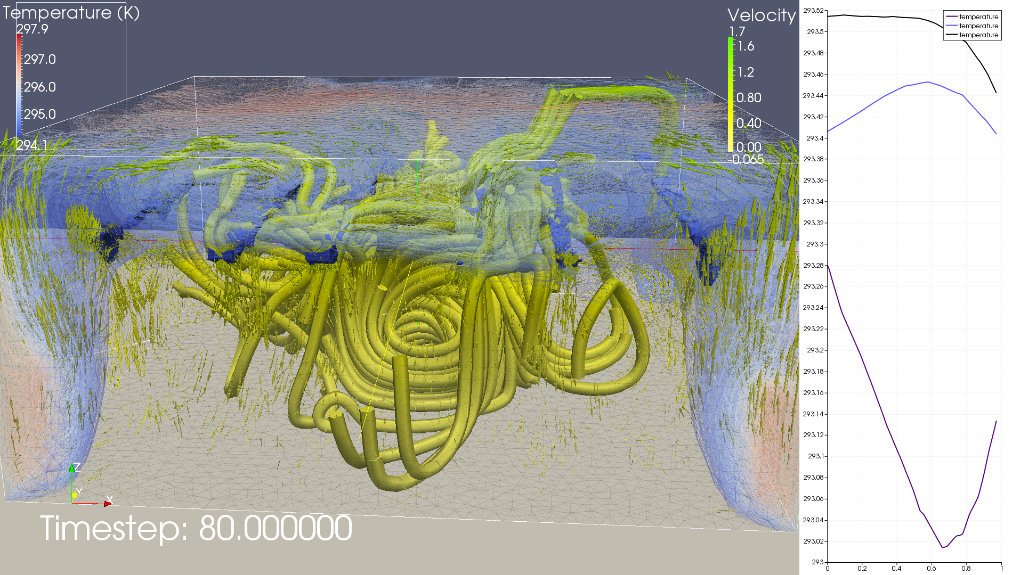

Slide 12
