Slide 1
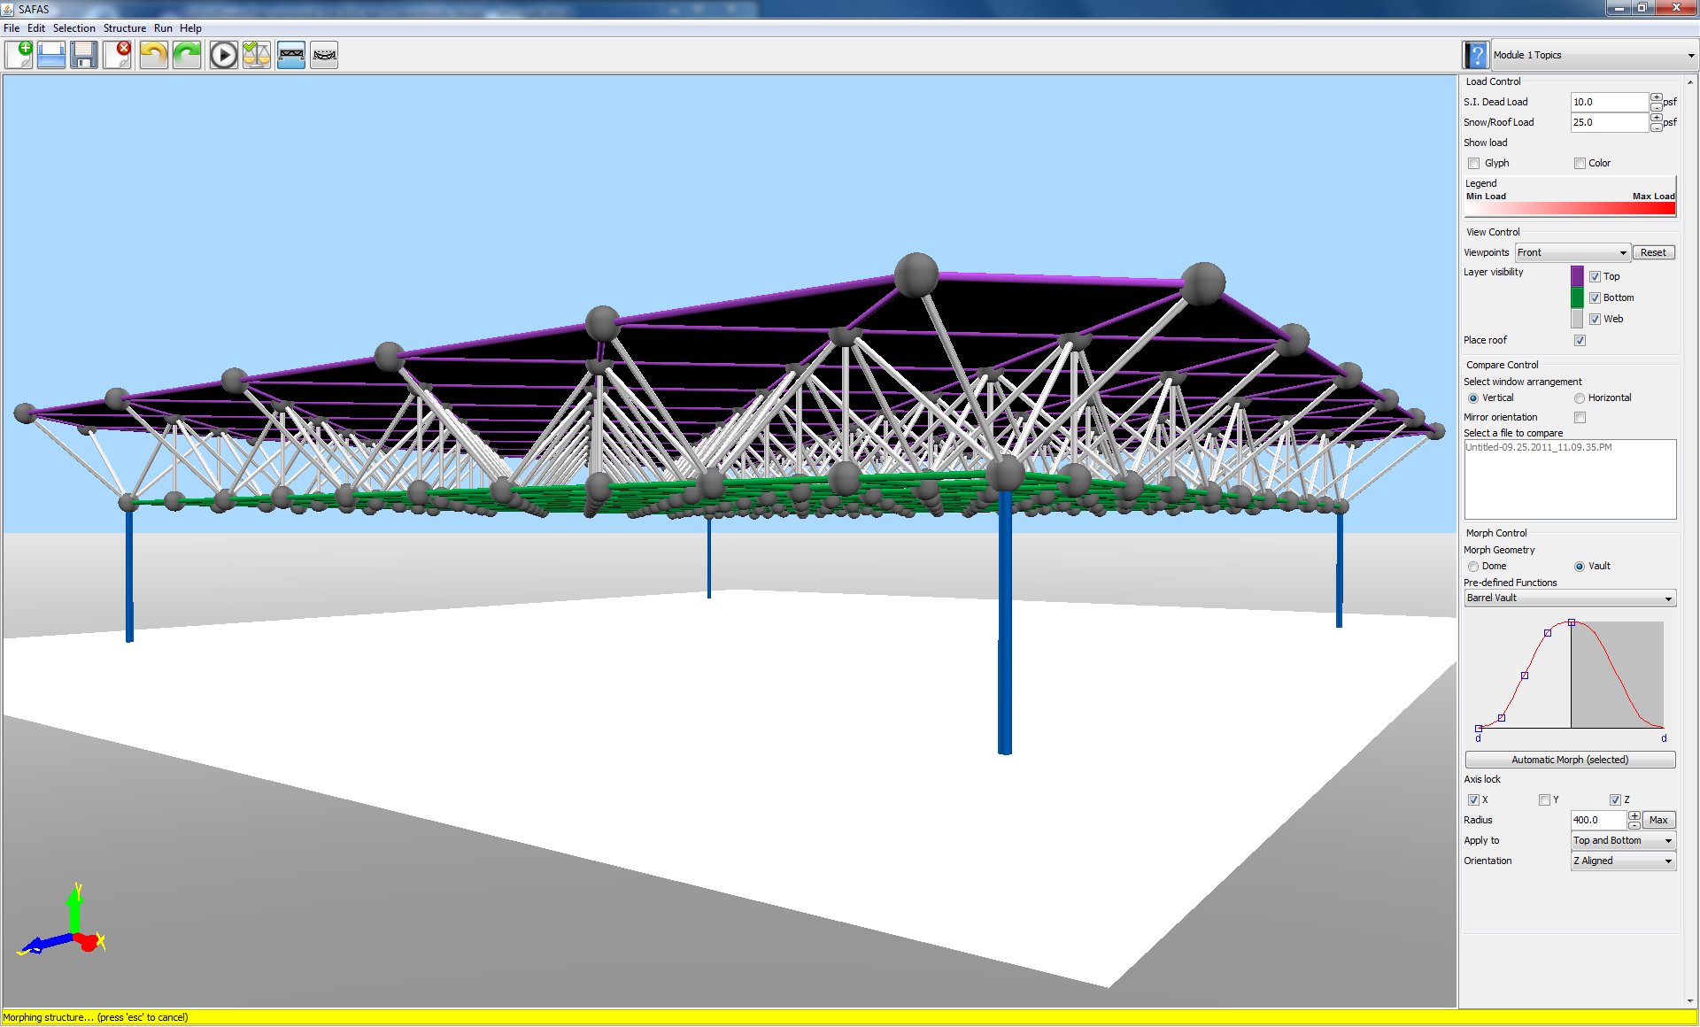
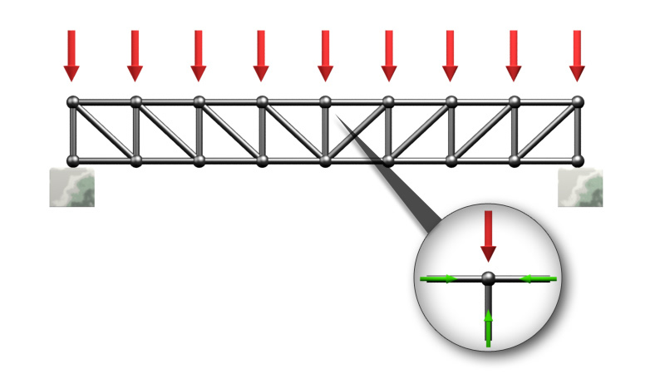
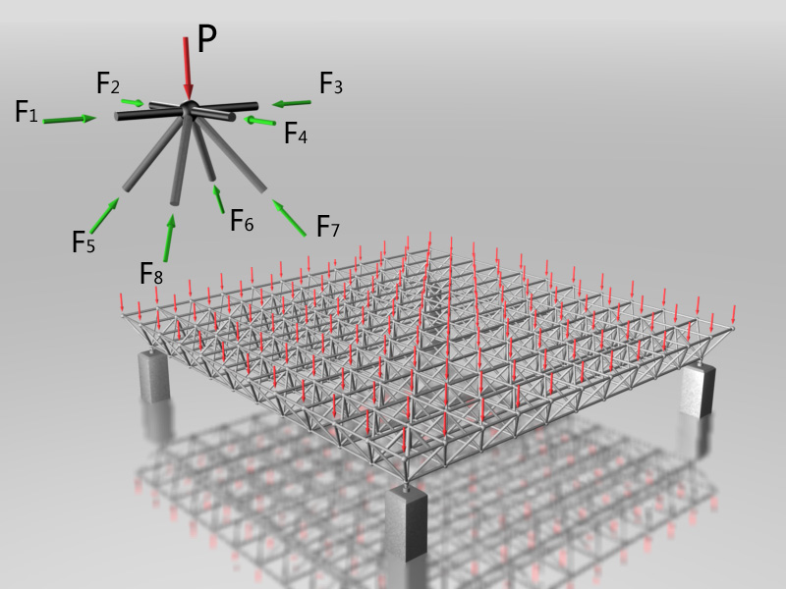
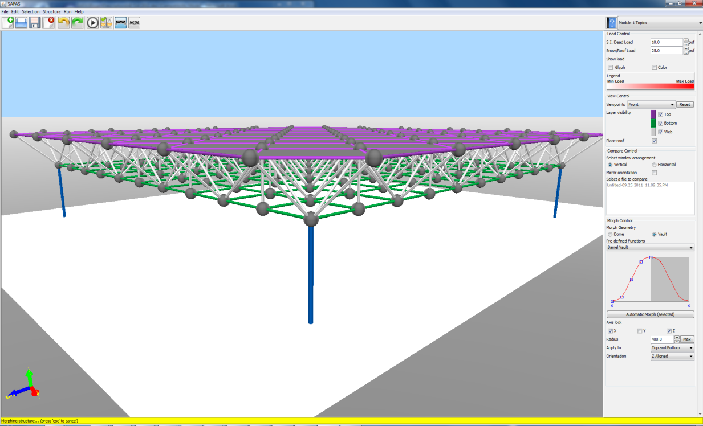
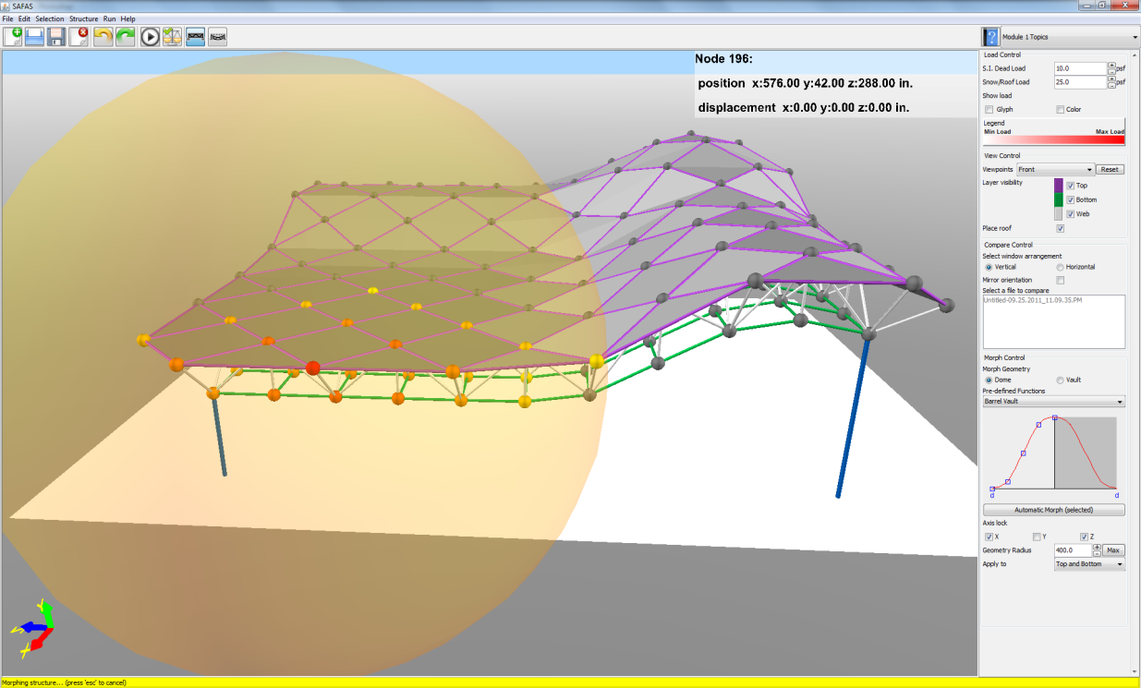
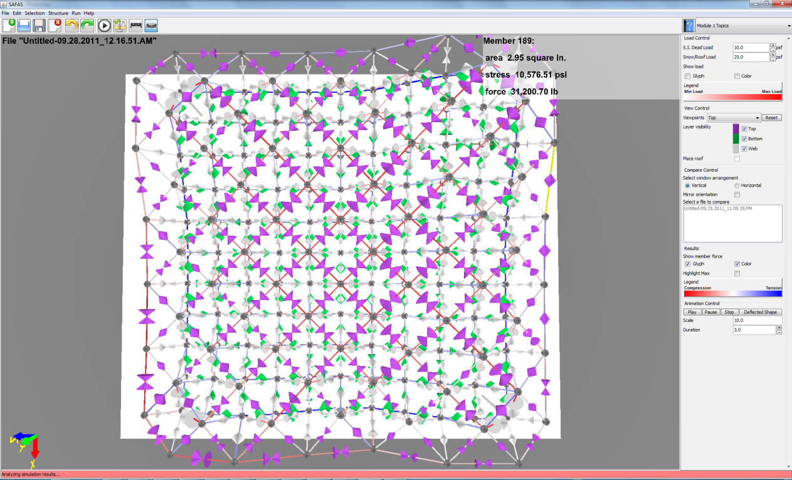
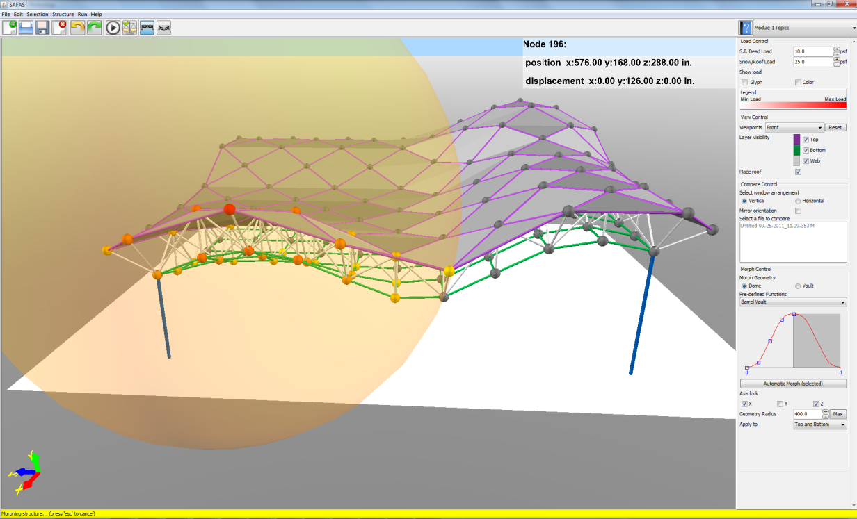
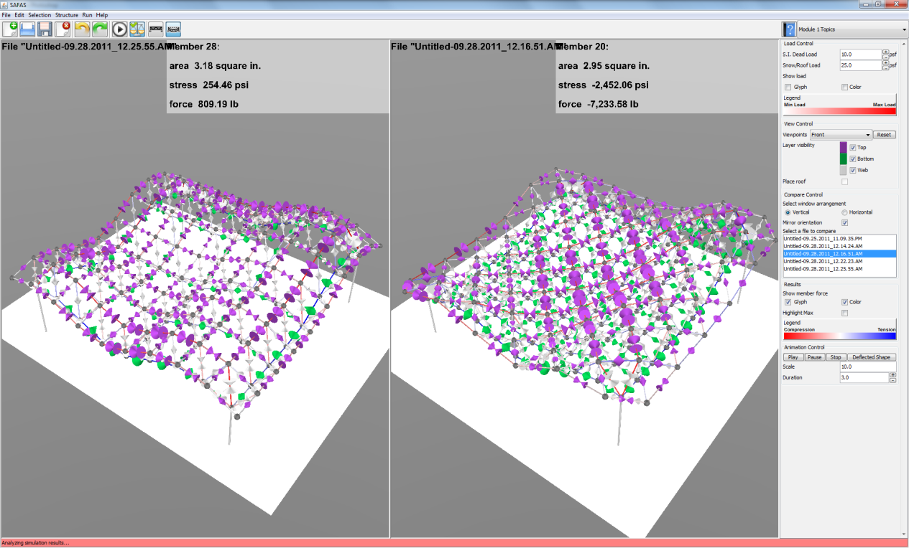
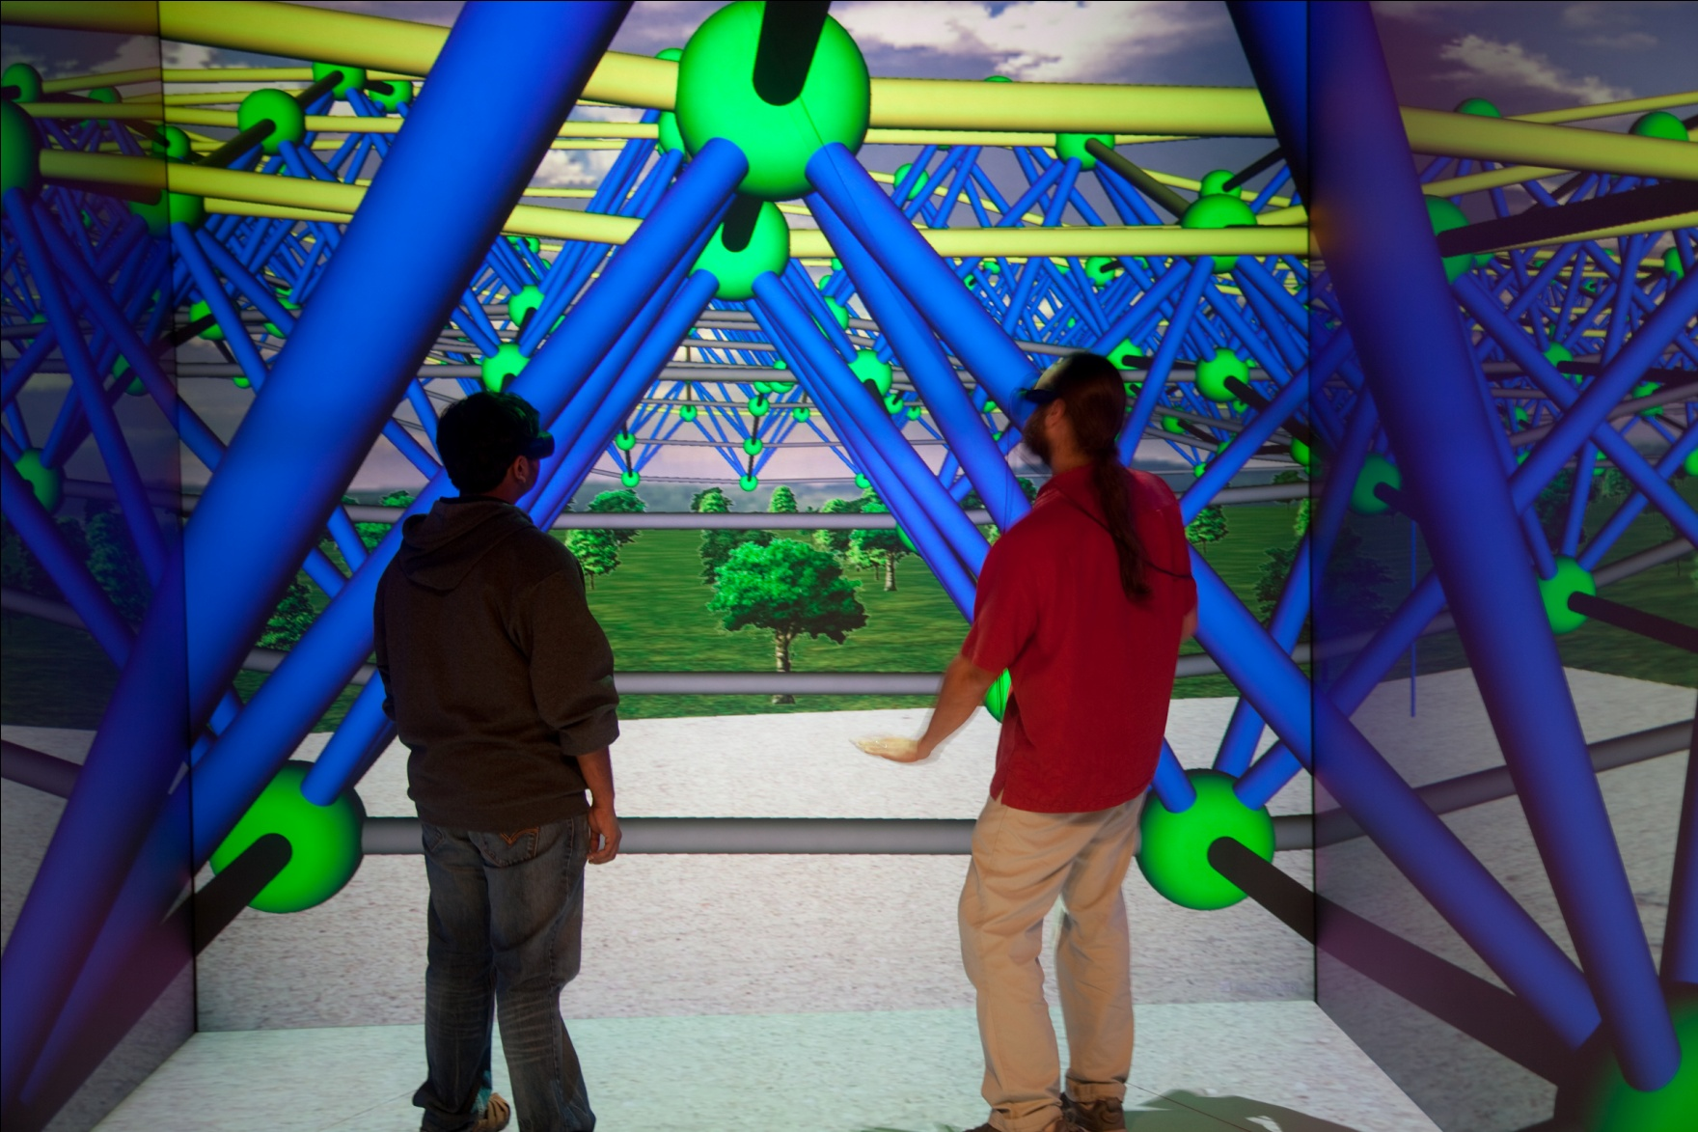
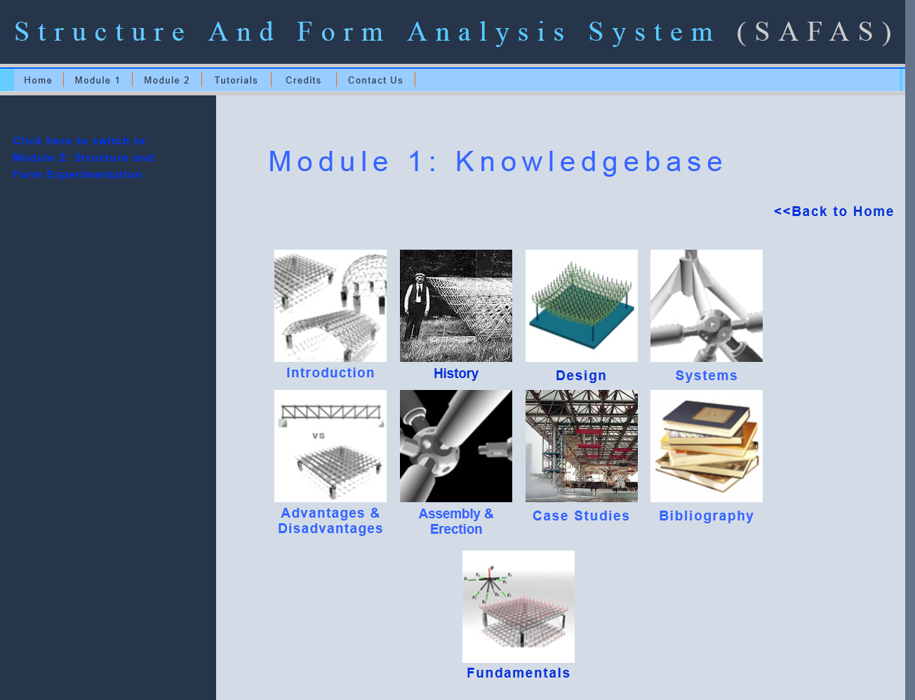
Project Type: New
Project Completion: 50 %
Project Title: Designing Form and Structure with Web3D Simulation
Research Team: Nicholas Polys Ph.D., Felipe Bacim, Mehdi Setareh Ph.D., Brett Jones Ph.D.
Thrust Area: Visualization and Virtual Prototyping, Engineering Education
Problem Statement
Related Work
There is a significant difference between tools used for the design of form and those that evaluate the structural properties of the form. We have integrated these into a usable design tool for students and practitioners to better understand the inter-relationships between
structure and form
Construct the Structure
Usability Engineering eLearning Systems-
A paradox: the domain expert is not the end user!
Bacim, F., Polys, N., Setareh, M., Chen, J., Li, J., & Ma, L. (2010). Cognitive Scaffolding in Web3D Learning Systems: A Case Study for Form and Structure. Paper presented at the Proceedings of the 15th International Conference on 3D Web Technology. ACM SIGGRAPH.
Define the Loads Based on the Occupancy Types
Perform the Structural Analysis/Design Using SAP2000
Revise the Model
Check the Deformed Shape of the Structure
Approach and Methods
Check the Color Coding for Element Stresses
How Ours is Different
An Architecture, Education and CS collaboration to develop and evaluate simulation tools for design education
Interactive 3D design client, web simulation and management services
Website with extensive text, image, video and 3D resources on space frame structures is linked from the Help menu
Run a series of studies on the information and interaction design of the client tool interface; specifically scientific visualization and direct manipulation morphing
Run a series of studies with the tool in undergraduate classes
Is the Structure Acceptable?
Key investment requirements for long-term impact of interactive 3D content includes: portability, interoperability and durability. Extensible 3D (X3D) is an open, royalty-free standard developed through the Web3D Consortium and ratified through the International Standards Organization (ISO). Our tool is based on the open-source Xj3D rendering library and provides designers web access to their runs on a structural simulation server.
Done
Project Plan (Tasks and Timeline)
Iterative development and evaluation of the tool functionality, interface, and integration with courseware
http://legacy.caus.vt.edu/setareh/archresearch
Evaluations
Formative:
  Scientific visualization of structural networks
  Deforming interactions in design
  Undergrad Architecture Studio (Spring 2011 Virginia Tech)
Summative:
  Undergrad Architecture Studio: Virginia Tech, U Illinois
  Urbana-Champlain, Hampton University (Fall 2011)
Deliverables and Benefits
  SAFAS Designer: 3D space frame designer with several interactive deformers and coupled to structural simulator (SAP v4 and SAP 2000) through the web
  Multimedia structures website (Dublin-core) with information, images, videos, and 3D
  Experimental data on principles for the visual perception of variables such as tensile force, stress, and load on structural members
NSF Funds 100 % : TUES / CCLI

