Slide 1
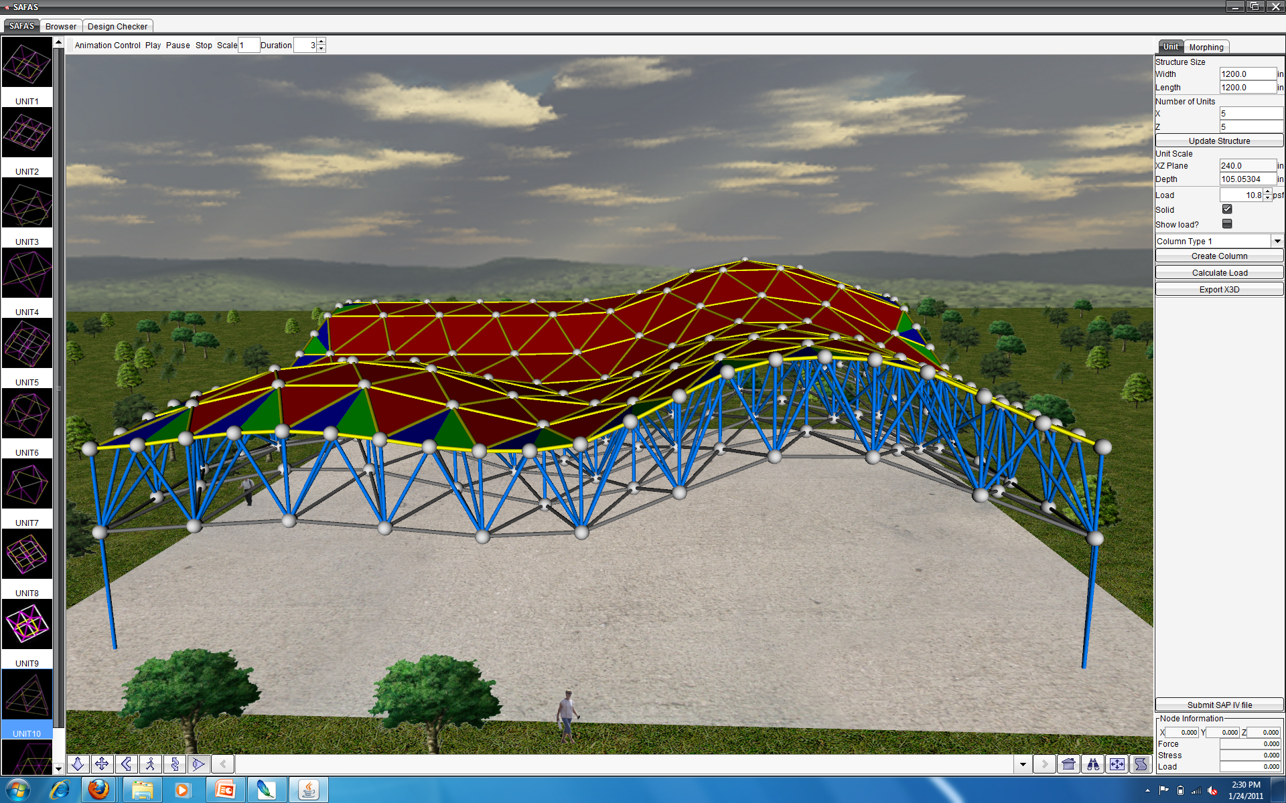

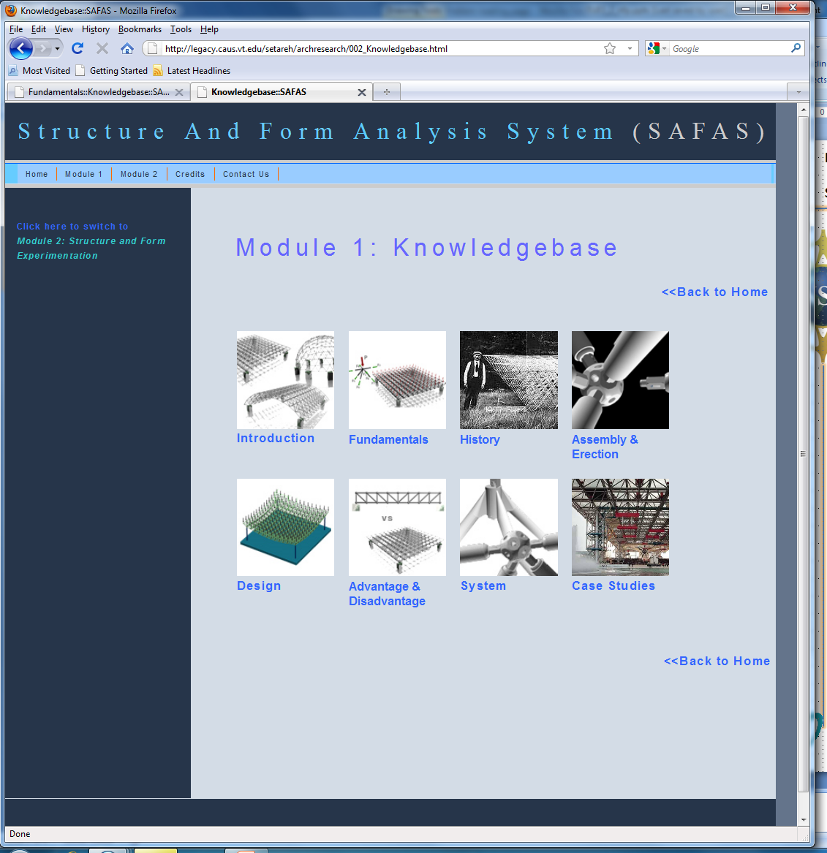
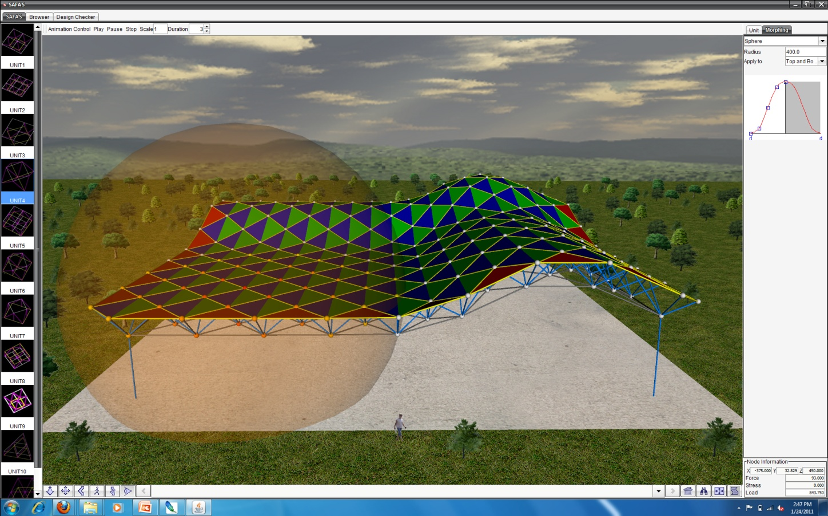
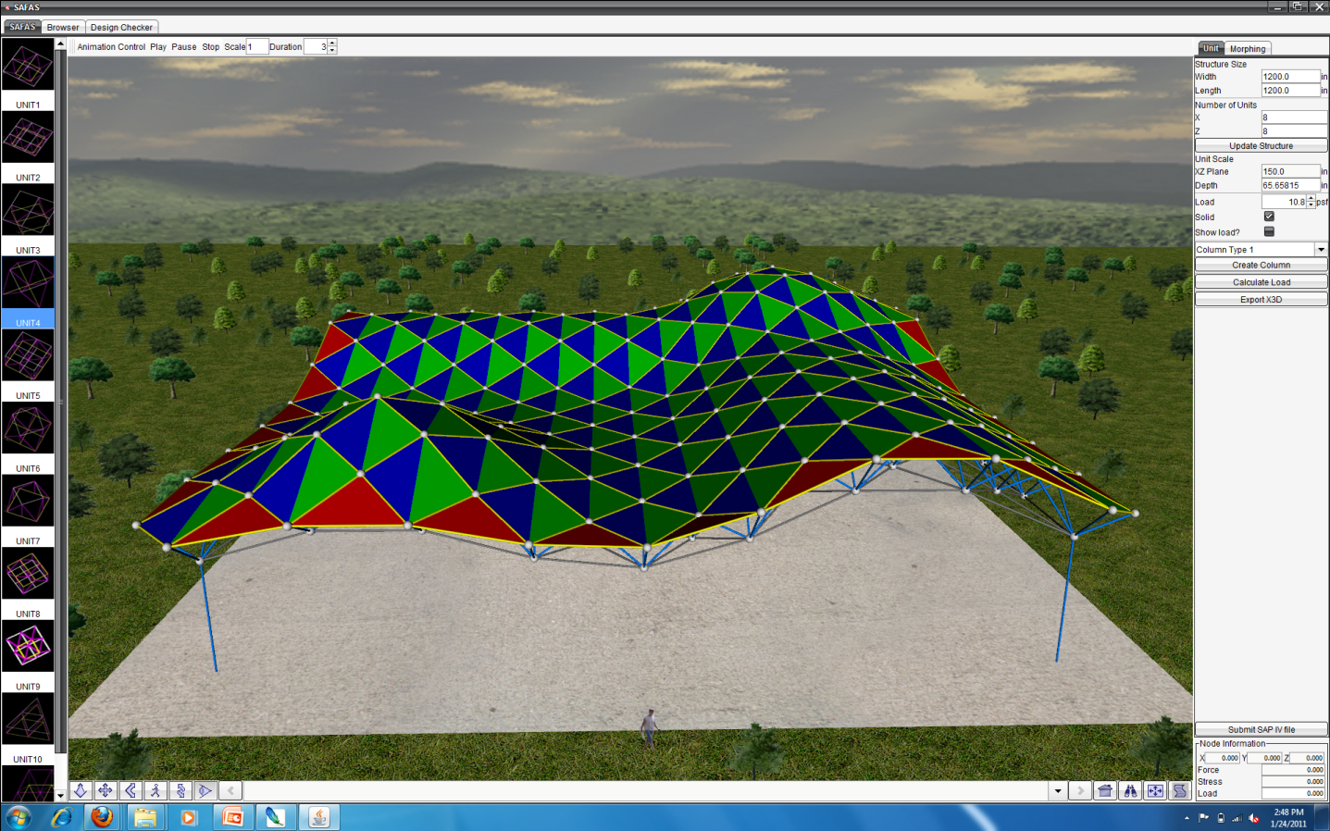
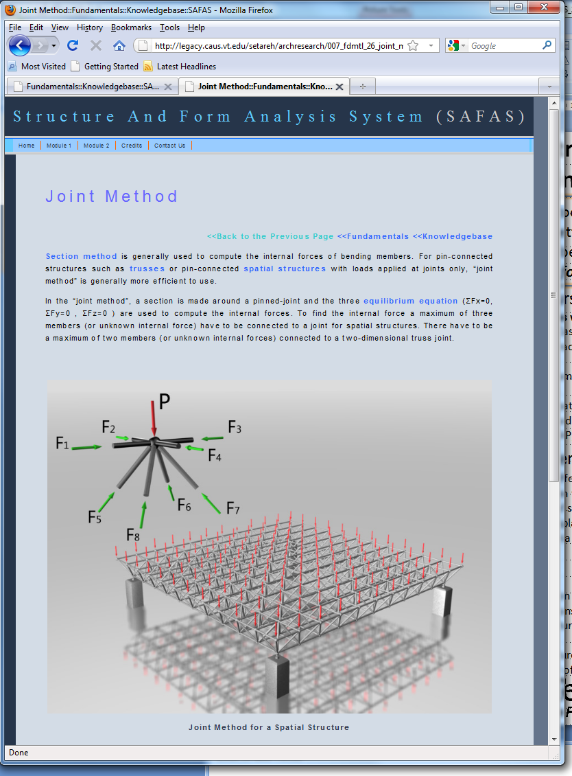
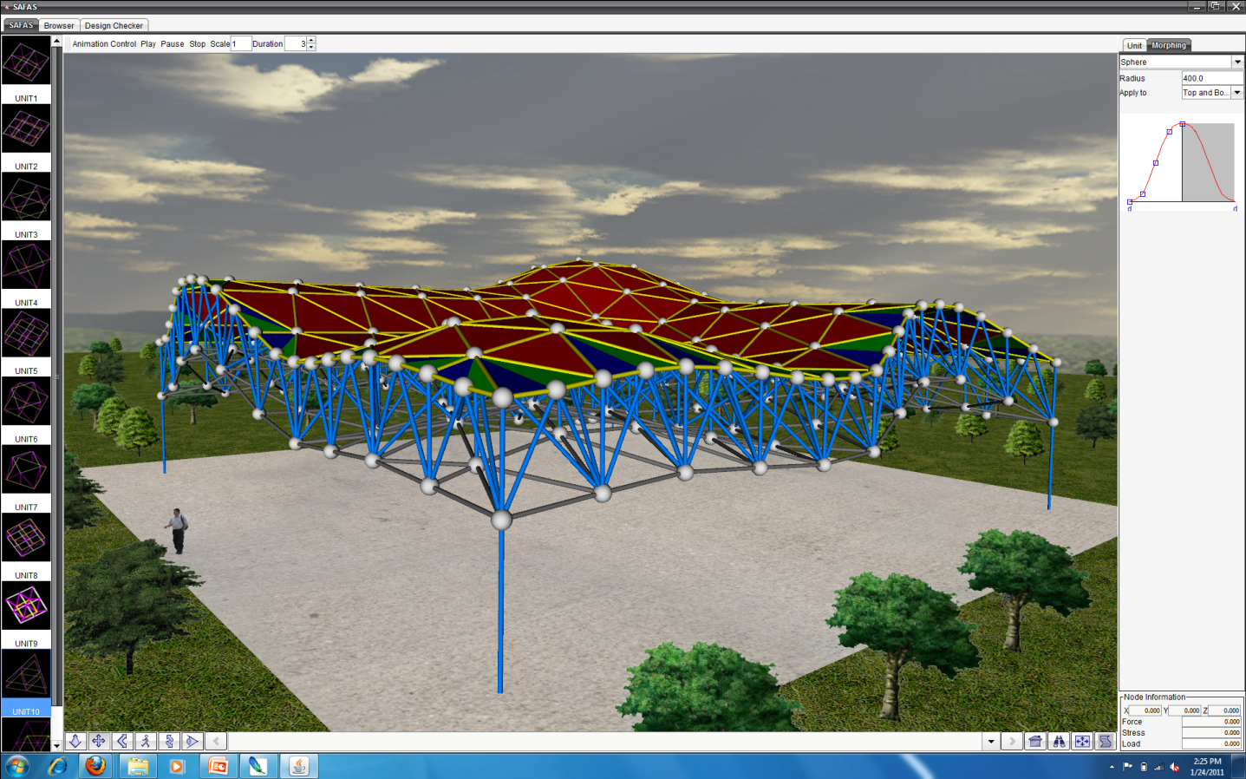
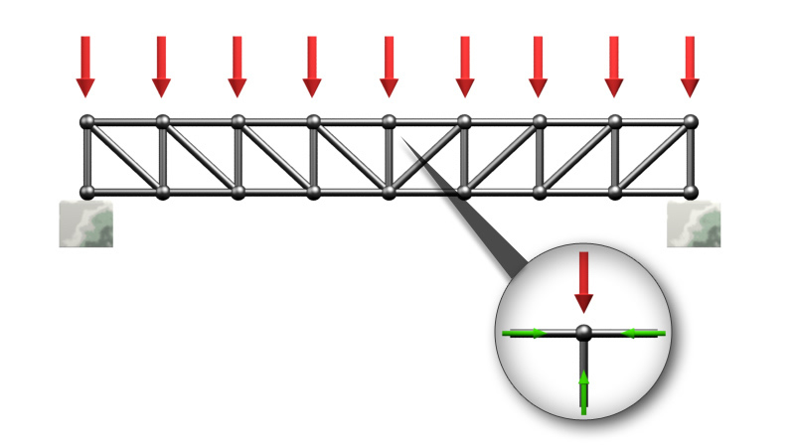
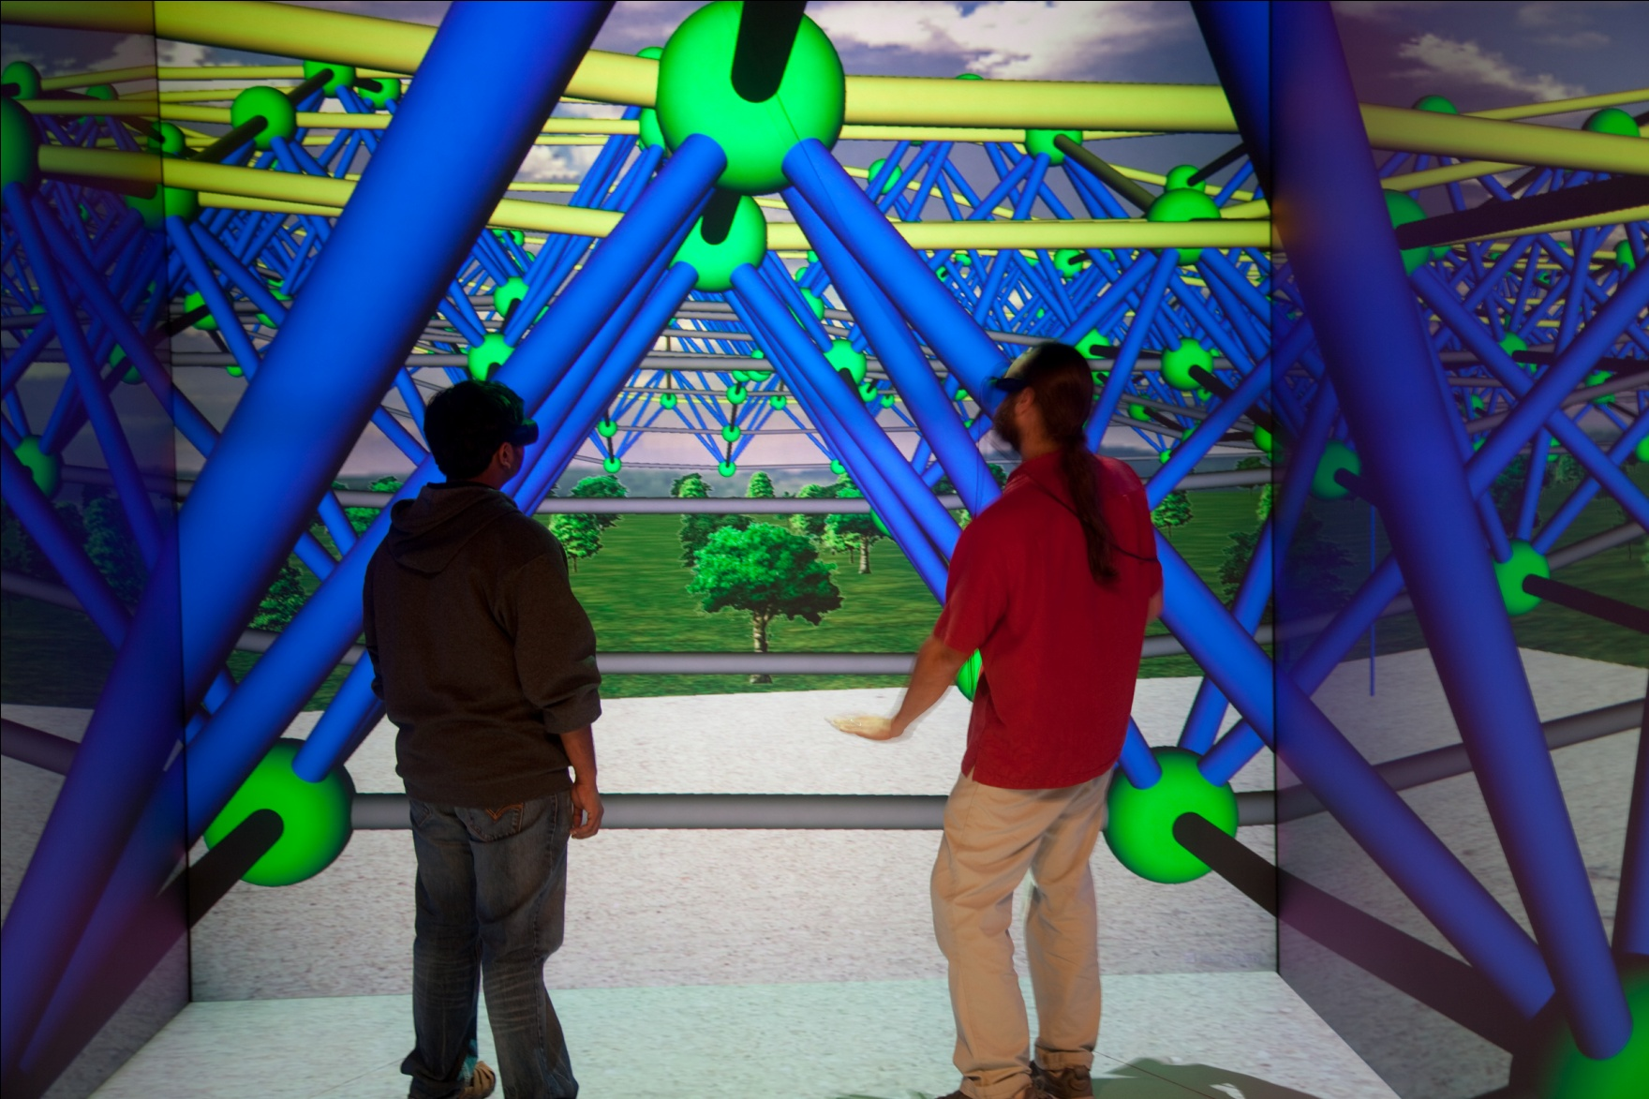
Improving Structural Understanding in Architecture
Principle Investigators: Mehdi Setareh, Ph.D., PE, Nicholas F. Polys Ph.D., Jian Chen Ph.D., Brett Jones, Ph.D., Michael Ermann
Students: Felipe Bacim, Ji Li, Li Ma, Tianyu Geng
Goal: educational tools for architectural students and architects to better understand the
inter-relationships between
structure and form
SAFAS:
an interactive
Web3D design tool coupled with SAP simulation.
Architecture Courseware
Multimedia Structures website
  History, Principles, Case Studies
  Image, movies, interactive 3D (X3D)
SAFAS DESIGNER
Interactive space frame designer
Multiple deformers
X3D and CIS-2 Compatible
Coupled to web-based Structural
Analysis Program (SAP) v4 and 2000
New Studio Materials
Design Projects: 11 different space
frame units; 2 column types
Direct manipulation of structure
Evaluate loads and displacement
Repeat until end criteria is reached
Evaluations
Formative:
  Scientific visualization of structural networks
  Deforming interactions in design
  Undergrad Architecture Studio (Spring 2011 Virginia Tech)
Summative:
  Undergrad Architecture Studio: Virginia Tech, U Illinois Urbana-Champlain, Hampton University
Usability Engineering
eLearning Systems
Interactive 3D Platforms
Paradox: The domain expert is not the end user.
“Cognitive scaffolding in Web3D learning systems: a case study for form and structure”. In Proceedings of the 15th international Conference on Web 3D Technology (Los Angeles, California, July 24 - 25, 2010). Web3D '10. ACM, 2010.
Client
Open source Java, based on the Xj3D toolkit; Students download and install
Interactive design and visualization of loads and displacements in the structure
Server
Student directories for designs and results
Deamon manages launching simulation engine (SAP by Computers and Structures Inc.)
For broad impact (and smart investment), interactive 3D content must be portable, interoperable, and durable.
Extensible 3D (X3D) is an open, royalty-free standard developed through the Web3D Consortium and ratified through the International Standards Organization (ISO).
In cooperation with the
Web3D Consortium and
the e-Learning Working Group:
www.web3d.org

