Slide 1
Interactive Textures as Spatial User Interfaces in X3D
Web3D 2010 Symposium
Sabine Webel
Y. Jung, M. Olbrich, T. Drevensek, T. Franke, M.Roth, D.Fellner,
Fraunhofer IGD - Virtual and Augmented Reality Group, Darmstadt
sabine.webel@igd.fraunhofer.de

Slide 2
Overview
Introduction and Motivation
Integrating Interactive Textures in X3D
Various types
Applications
Virtual Reality
Augmented Reality
Conclusion and Future Work

Slide 3
Introduction & Motivation
3D applications can require complex user interaction
Typical task for standard user interfaces
Solution in 2D space
Buttons, sliders etc.
Replication of these functionalities in 3D space
3D GUI elements not convincing (especially for immersive environments)
No standard for selecting and manipulating objects in 3D scenes
3D GUI elements often created from the scratch
Experience and skills in GUI design required
3D GUIs often rendered parallel to the viewing plane
2-dimensional appearance
Our approach
2D interfaces in 3D applications via interactive textures

Slide 4
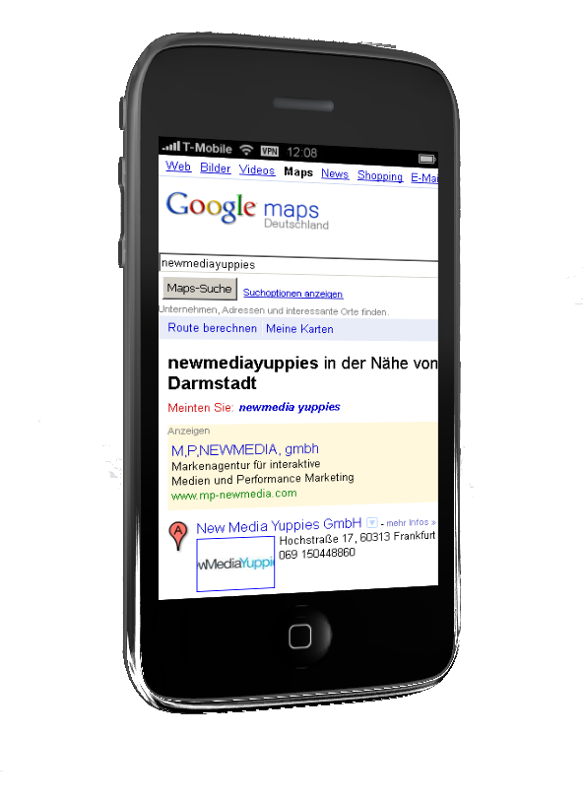
Extending the X3D texturing concept Integrating interactive textures in X3D
Integration of commonly used 2D UI frameworks in X3D
Set of new X3D node types
X3D Texturing component (single 2D texture maps)
ImageTexture, PixelTexture (still)
MovieTexture (video)
New node set enables to embed:
standard 2D UIs
web-content
full applications
Interactive texture input via keyboard and mouse
Open enough for more advanced input devices (e.g. UserBody [1])
Suitable for desktop apps and fully immersive environments
no interactivity
[1] Behr, J., Dähne, P., and Roth, M., 2004, “Utilizing X3D for immersive environments“, Web3D ’04

Slide 5
InteractiveTexture node Interface of the base node
InteractiveTexture : DynamicTexture {
...
SFBool [in,out] enabled TRUE
SFString [in,out] updateMode "onInteraction"
SFFloat [in,out] maxFps 10
SFVec2f [in] pointer
SFBool [in] button
SFString [in] keyPress
SFString [in] keyRelease
SFInt32 [in] actionKeyPress
SFInt32 [in] actionKeyRelease
SFBool [in] altKey
SFBool [in] controlKey
SFBool [in] shiftKey
}
pointer: 2D position of the texture → UI native space
button: clicking or similar binary actions
E.g. X3D TouchSensor
hitTexCoord_changed → pointer
isActive → button

Slide 6
InteractiveTexture node Interface of the base node
InteractiveTexture : DynamicTexture {
...
SFBool [in,out] enabled TRUE
SFString [in,out] updateMode "onInteraction"
SFFloat [in,out] maxFps 10
SFVec2f [in] pointer
SFBool [in] button
SFString [in] keyPress
SFString [in] keyRelease
SFInt32 [in] actionKeyPress
SFInt32 [in] actionKeyRelease
SFBool [in] altKey
SFBool [in] controlKey
SFBool [in] shiftKey
}
Keyboard input according to X3D KeySensor
all outSlots as inSlots

Slide 7
InteractiveTexture node Interface of the base node
InteractiveTexture : DynamicTexture {
...
SFBool [in,out] enabled TRUE
SFString [in,out] updateMode "onInteraction"
SFFloat [in,out] maxFps 10
SFVec2f [in] pointer
SFBool [in] button
SFString [in] keyPress
SFString [in] keyRelease
SFInt32 [in] actionKeyPress
SFInt32 [in] actionKeyRelease
SFBool [in] altKey
SFBool [in] controlKey
SFBool [in] shiftKey
}
updateMode:
mouse-move-like events
click-like events
time-based
maxFps: max. update frequency

Slide 8
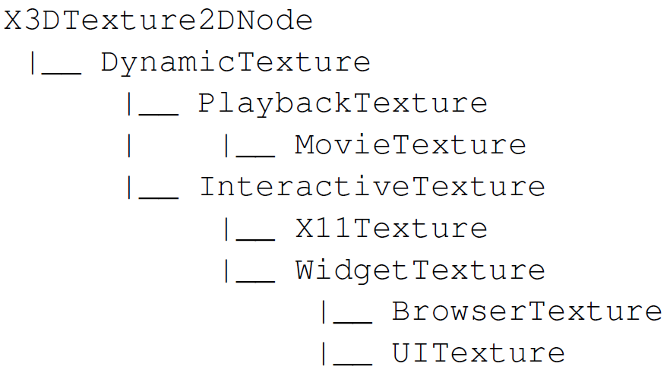
Node inheritance hierarchy
Derived from abstract X3DTexture2DNode
New abstract node type: DynamicTexture
Base type of all time- and interaction-dependent textures
PlaybackTexture: play-back 2D content without interaction
InteractiveTexture: interactive GUI
X11Texture: displays X11 screen
WidgetTexture: displays widget-based GUI elements
BrowserTexture: displays web-pages
UITexture: displays Qt-based dialog file (UI files)

Slide 9
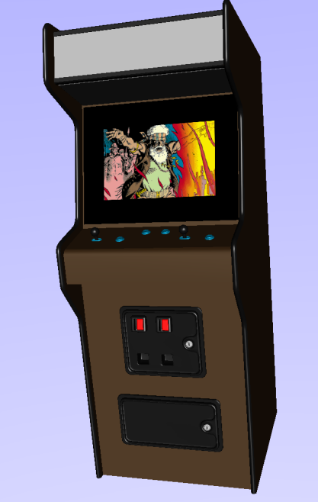
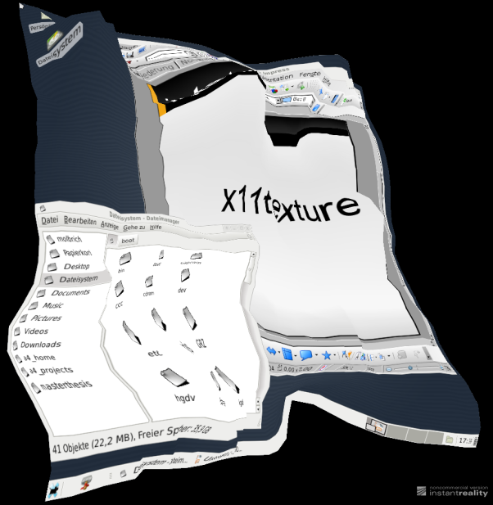
X11Texture node Implementation and interface
X11Texture : InteractiveTexture {
...
SFString [] xserver "/usr/bin/Xvfb"
SFString [] shell "/bin/bash"
SFInt32 [] display 3
SFString [in,out] command ""
}
Can map entire desktop environments
Displays X11 screen using Xvfb
Allows running single applications without a desktop manager
Only on Unix platforms
X11Texture parameters related to Xvfb
xServer: location of the Xvfb server app
shell: environment for the execution
display: X11 display to be used
command: command (or app) launched inside the server (e.g. „xterm –e top“)

Slide 10
WidgetTexture node Implementation and interface
Base type for textures representing widget-based GUI elements
i.e. widgets which display PDF-files
Qt-based
Platform independent
WidgetTexture : InteractiveTexture {
...
SFBool [in,out] show FALSE
MFString [in,out] url []
}
show:
determines if the dialog is shown in a separate window
useful for debugging and rapid prototyping

Slide 11
BrowserTexture node Implementation and interface
BrowserTexture : WidgetTexture {
...
SFBool [in,out] delegateLinkHandling FALSE
SFBool [in] back
SFBool [in] forward
SFBool [in] reload
SFBool [in] stop
SFString [out] link_changed
SFBool [out] isLoaded
SFFloat [out] progress
}
Can display web-pages
Based on Qt-Webkit
url: denotes location of the web-page or contains embedded (D)HTML code
link_changed: updated with new url if link clicked
delegateLinkHandling:
TRUE → texture‘s location is updated with the web-page of the clicked link
FALSE → current page is kept and only link_changed eventOut is updated

Slide 12
BrowserTexture node Implementation and interface
BrowserTexture : WidgetTexture {
...
SFBool [in,out] delegateLinkHandling FALSE
SFBool [in] back
SFBool [in] forward
SFBool [in] reload
SFBool [in] stop
SFString [out] link_changed
SFBool [out] isLoaded
SFFloat [out] progress
}
back: load previous document in list
forward: load next document in list
reload: reload current document
stop: stop loading
isLoaded: sent when loading finished
progress: sends loading progress (0…1)

Slide 13
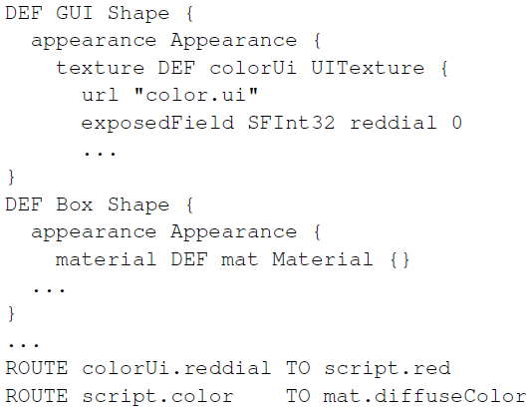
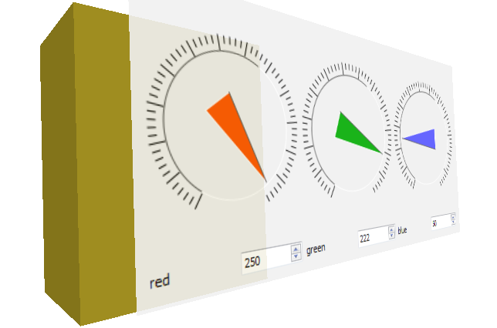
UITexture node Implementation and interface
Can display and handle Qt Designer UI files
url: location of the UI file
Dynamic fields represent signals and slots as defined in the UI file (Qt concept for event propagation [1])
[1] NOKIA, 2010. Qt – cross-platform application and UI framework. http://qt.nokia.com/.

Slide 14
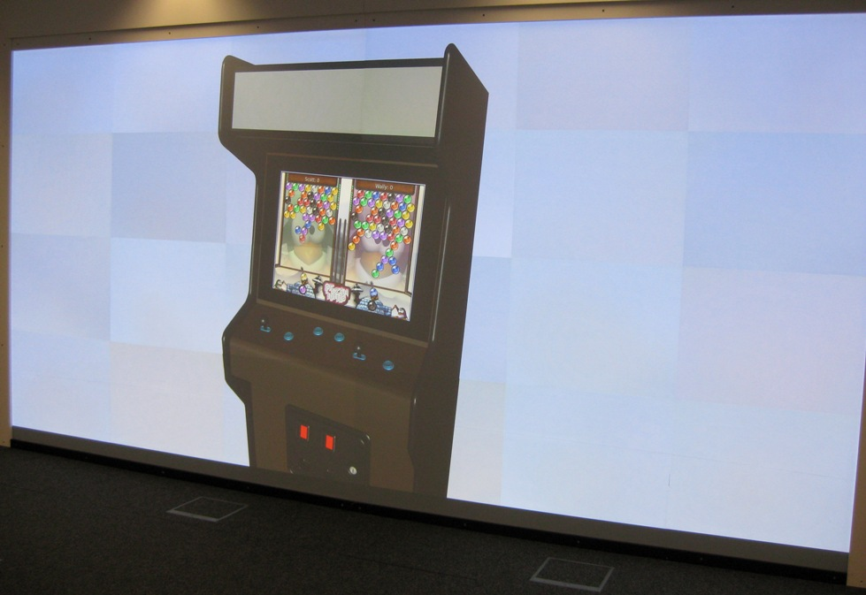
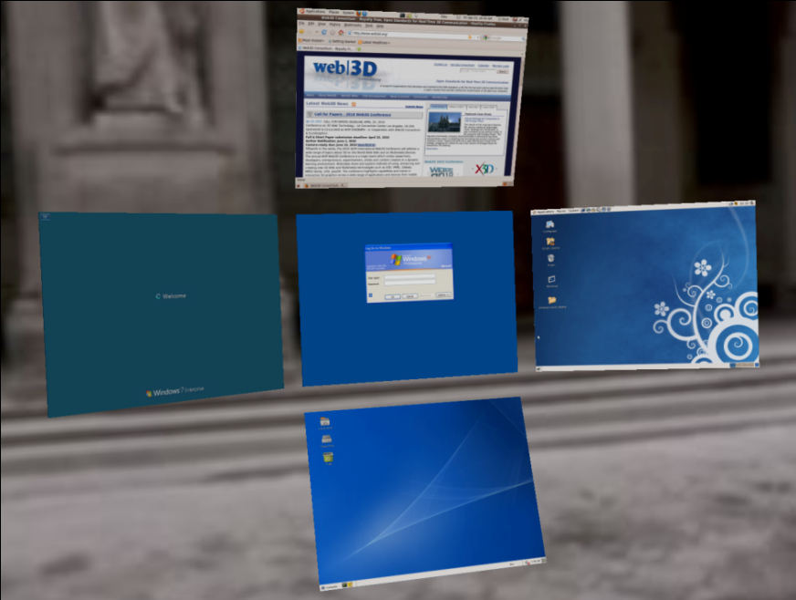
Applications

Slide 15
Applications

Slide 16
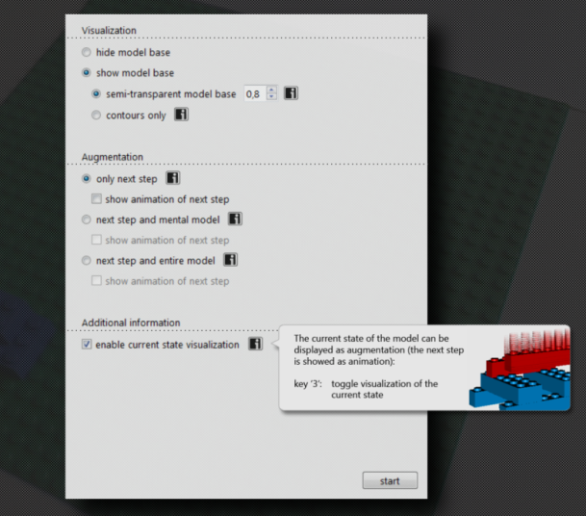
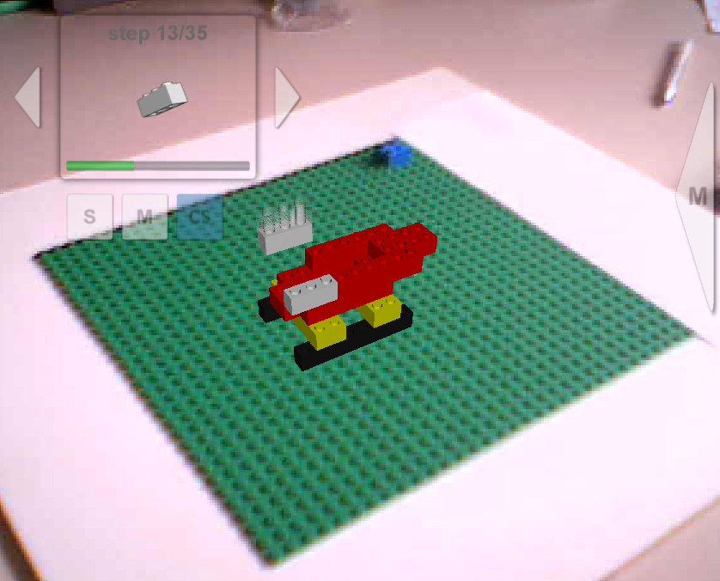
Applications

Slide 17
Conclusion and Future Work
Our issue: New set of nodes to integrate 2D GUIs into X3D environments
Interactive textures are used to map the 2D elements onto geometries
Different kind of content (standard 2D Uis, web-content, full applications)
Interaction with the textures via pointing devices and keyboard
Scales from standard desktop applications to fully immersive environments
Future work
Enable modification of pointer position by texture transforms
Investigation if the discussed 2D UI protocol can be generalized
Investigation if the X11 protocol can be generalized for other operating systems (if a similar protocol is available)

Slide 18
Interactive Textures
Thank you!

